Slide 1
Visual Thinking Strategies
Using former student work

Slide 2
Essential Question:
Do you think artwork is used as a way to communicate? Why or Why not?

Slide 3

What is going on in this picture?
What makes you say that?

Slide 4
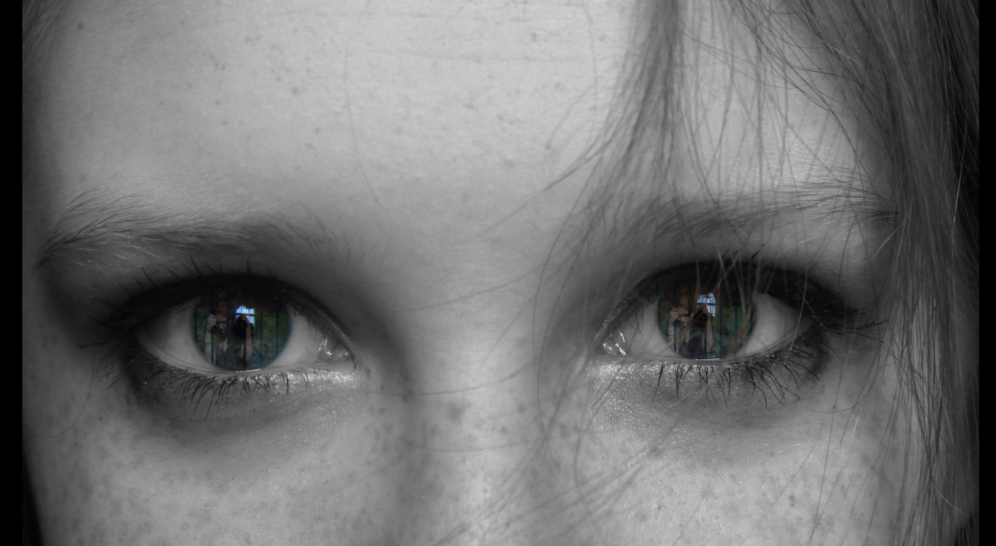
What is going on in this picture?
What makes you say that?

Slide 5
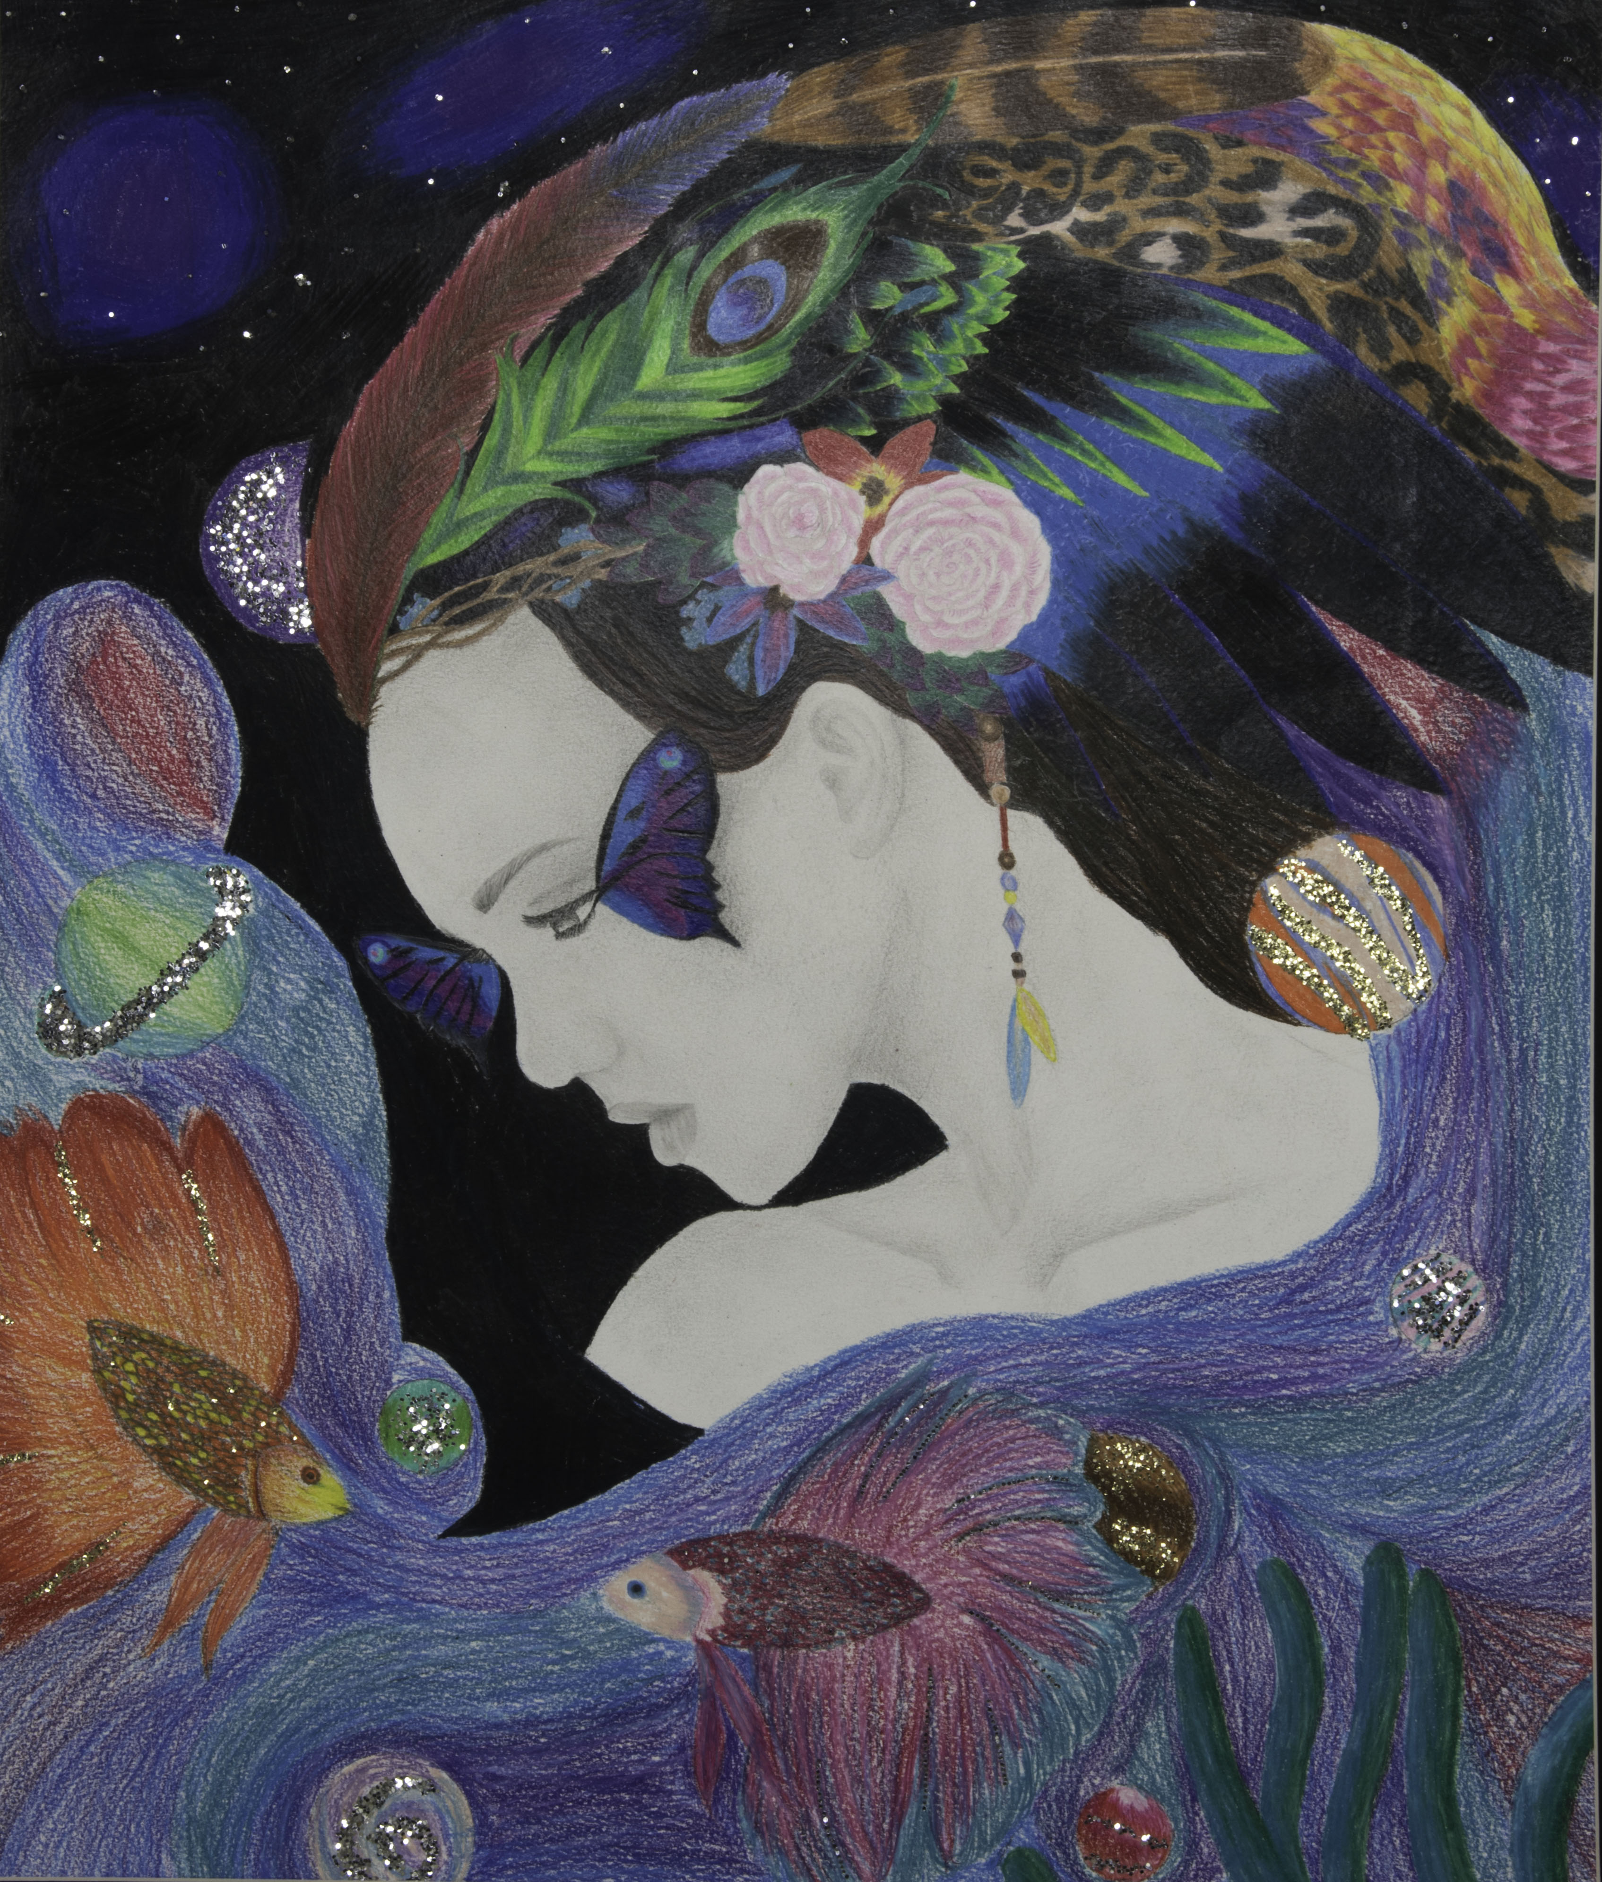
What is going on in this picture?
What makes you say that?

Slide 6
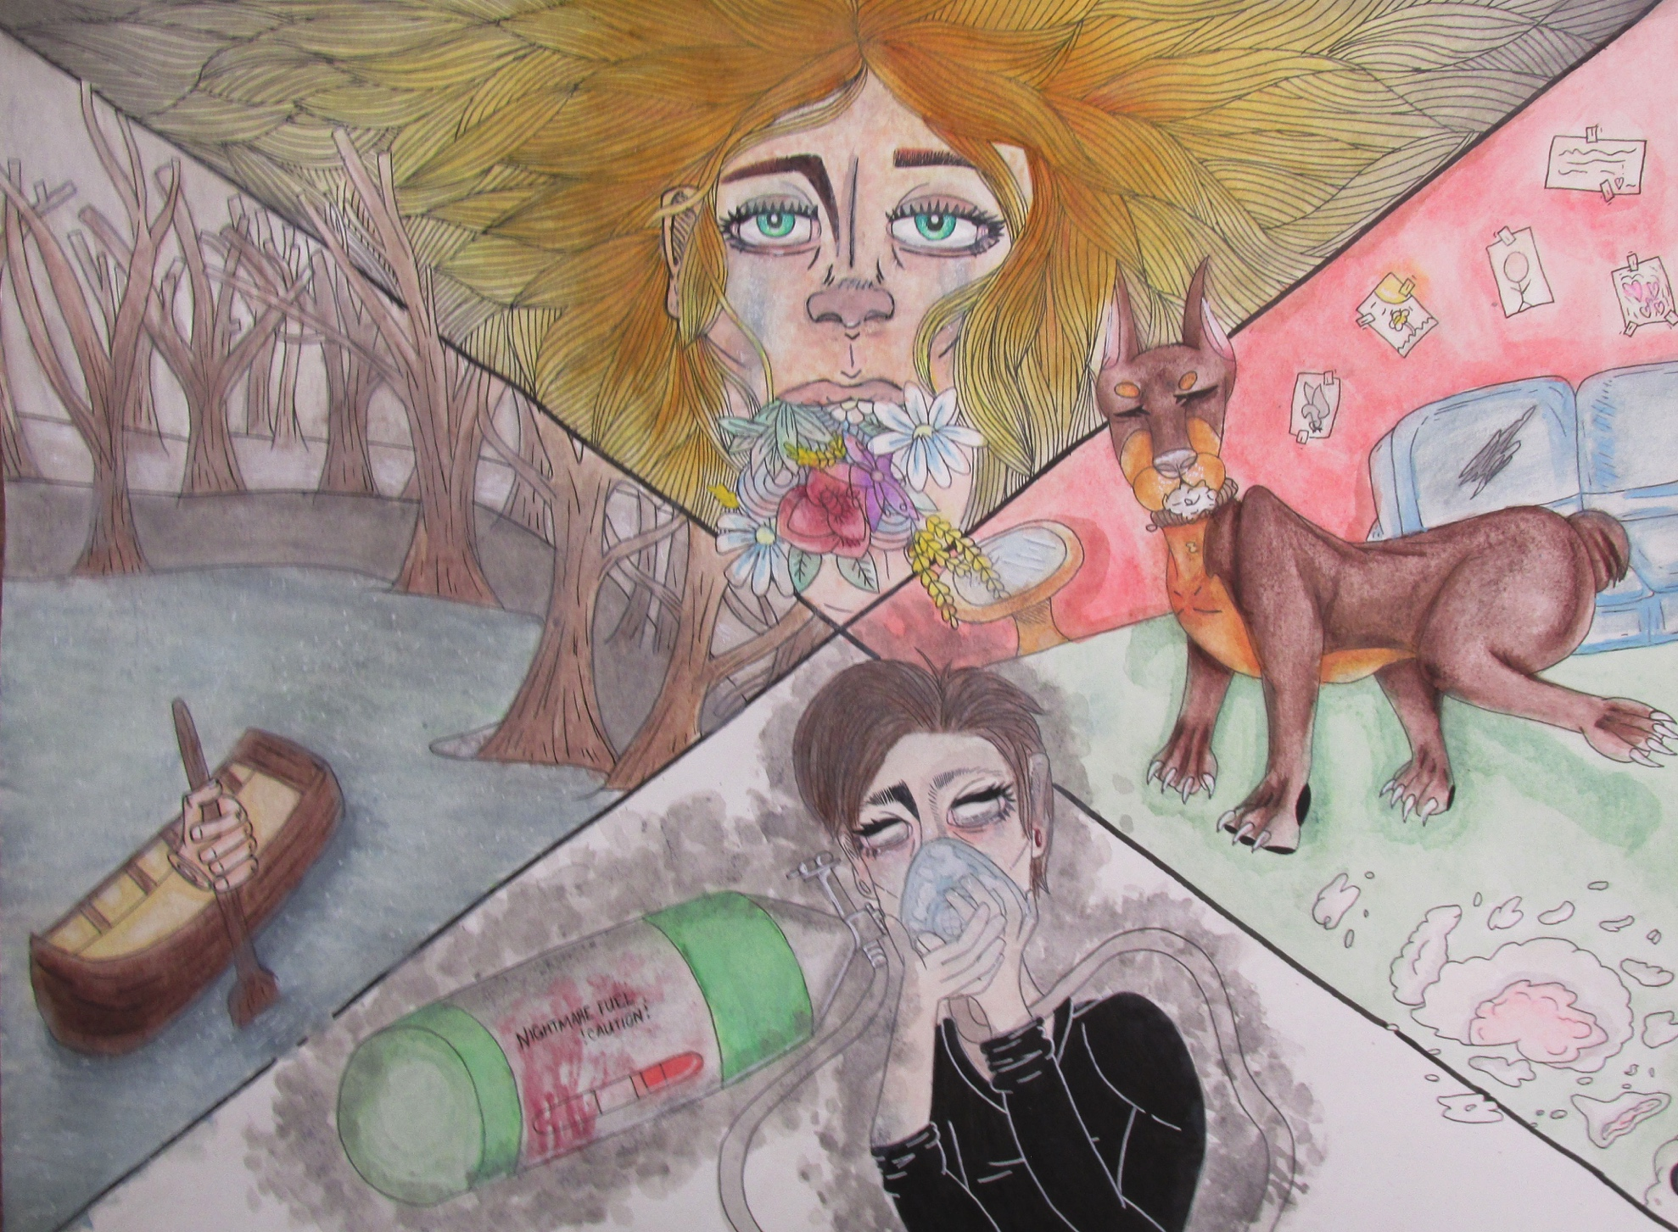
What is going on in this picture?
What makes you say that?

Slide 7
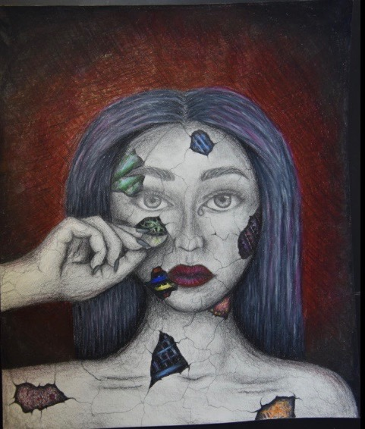
What is going on in this picture?
What makes you say that?

Slide 8
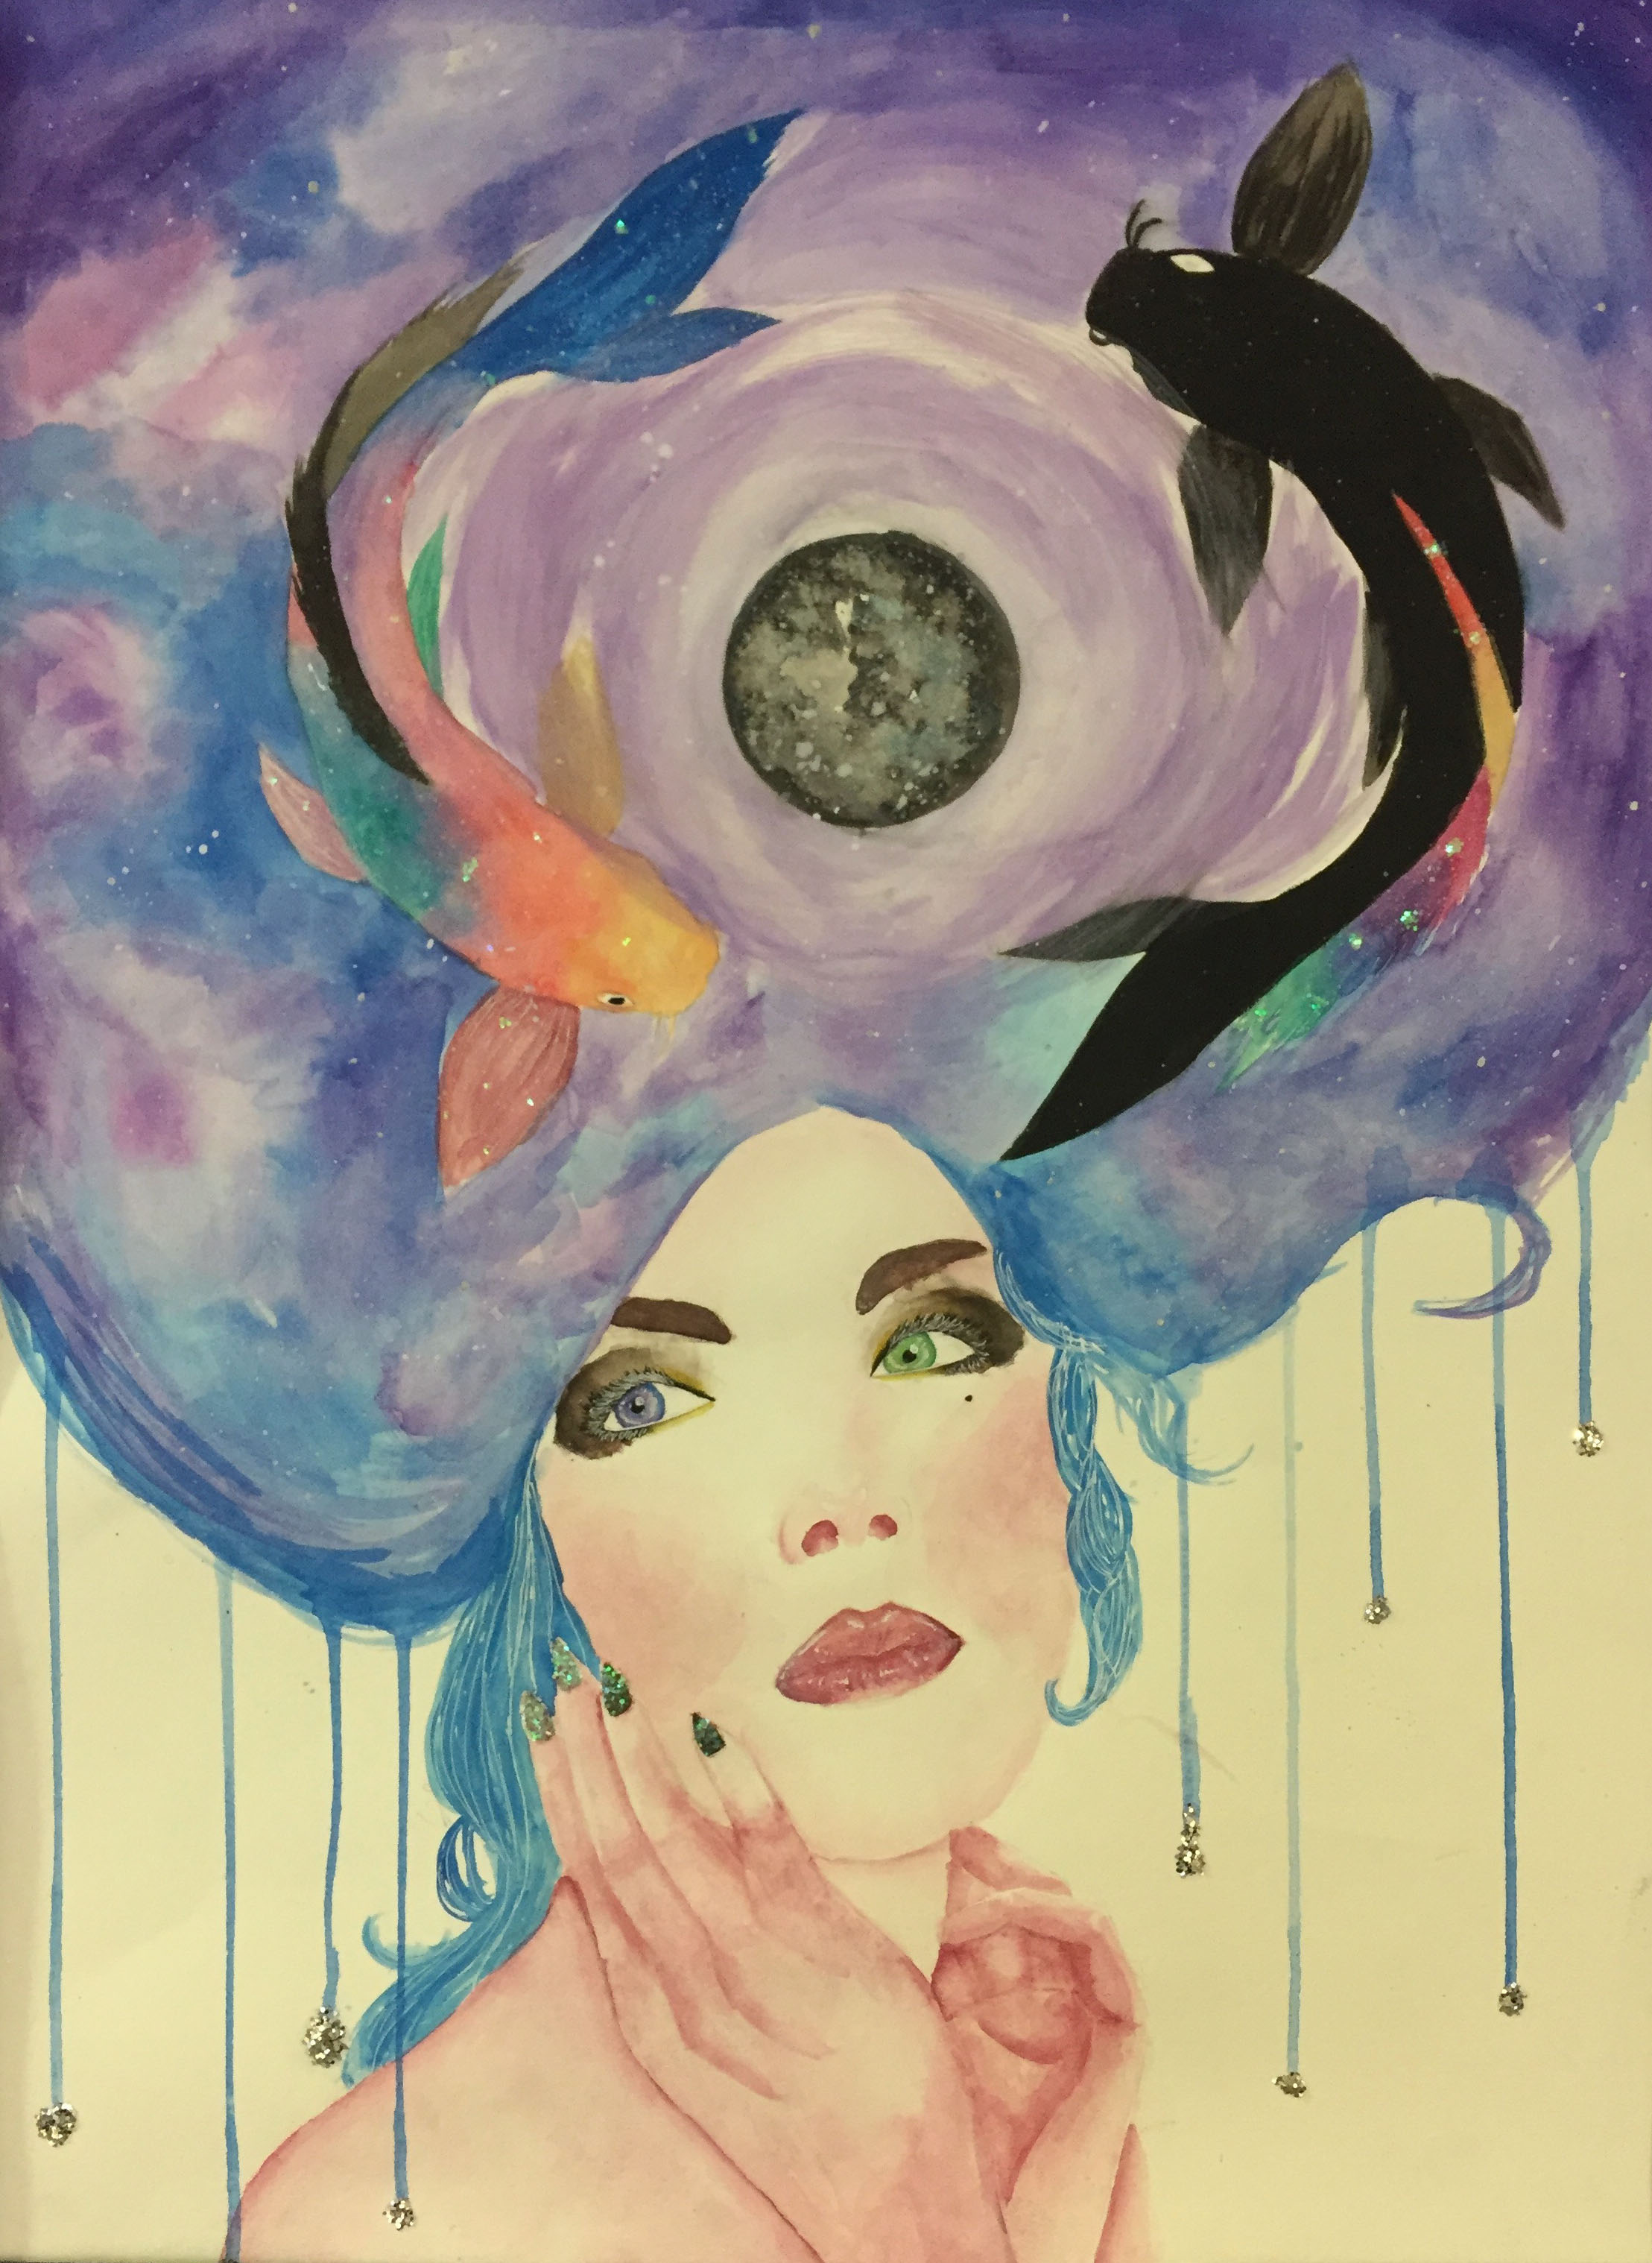
What is going on in this picture?
What makes you say that?

Slide 9
Exit Slip
I think this artwork was about ________________________________________.
One reason I think that is _____________________________________.

