Slide 1
The basics of color theory
Photo 1

Slide 2
Hue: The name of a color (green, blue, red, etc)
Notes:
Color, as we know it in regards to photography, is usually discussed in terms of hue, saturation, and brightness. Hue is the color part of color. When we say a color is blue, purple, or yellow, we're generally talking about hue. It’s natural color before any shades, tints, or tones are added.

Slide 3
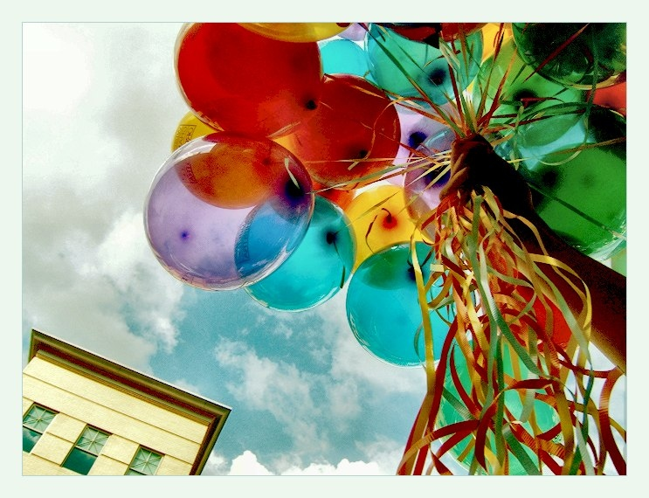
Notes:
for a good photographer, color is a integral part of the constant image processing we do in our heads. We don't just see a composition in terms of lines and shapes; we see the colors in it and the way they work in harmony. Color can make or break a work of art and that is also true in the photography world so it's a good idea to have some clue what it's all about.

Slide 4
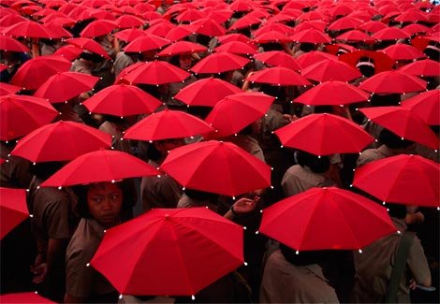
Notes:
It's well known that color can affect mood and, like particular shapes and lines, can be used to evoke feelings. Knowing what colors create which moods will help out any photographer.

Slide 5
Brightness: The quality of visual perception that varies with amount or intensity of light

Slide 6
Saturation: How vivid a color is (The POW of a color)
Notes:
Saturation (also called chroma) is the degree to which a color is colorful, as opposed to grayscale. So you might ask yourself the question, “Just how blue is that blue? A more saturated color looks more pure, while a less saturated color looks more dirty or diluted. Most colors found in nature are relatively unsaturated -- natural, pure color is fairly rare.

Slide 8
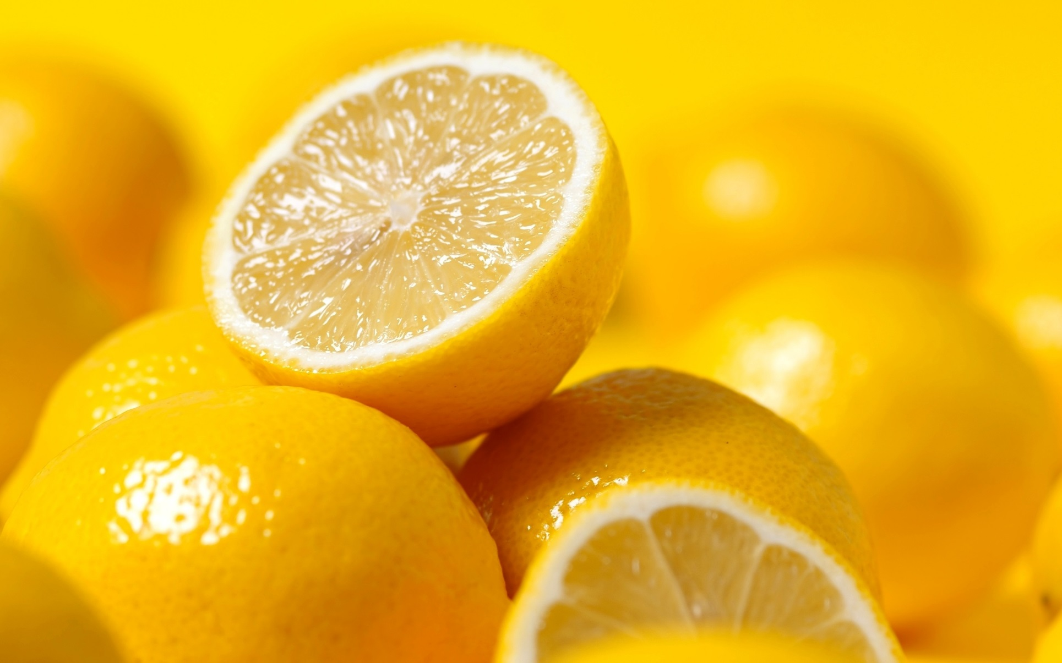
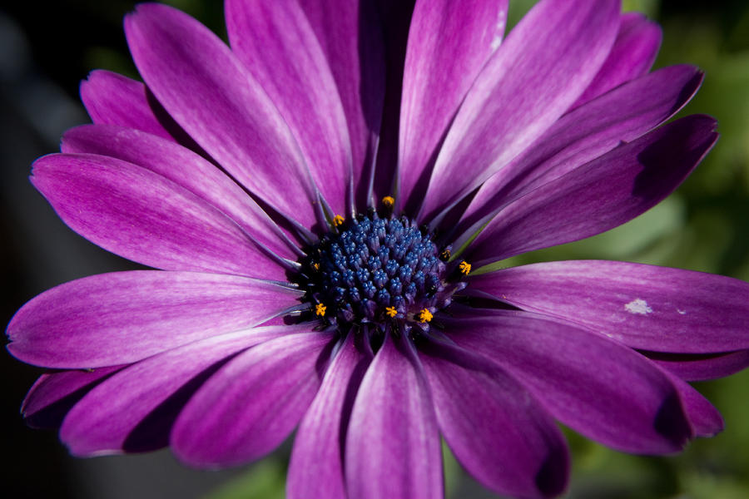
Intensity and harmony
Notes:
Each color has a different intensity than others. Take the color yellow for example. This hue is much brighter than that of let’s say purple. In art, warmer colors are more intense than cooler colors, and they tend to appear to advance toward us, while cooler colors appear to recede.

Slide 9
Color Schemes
Complimentary
Analogous
Monochromatic
Notes:
Color Schemes or color harmonies are colors that work well with one another. That don’t clash but actually enhance one another.

Slide 10
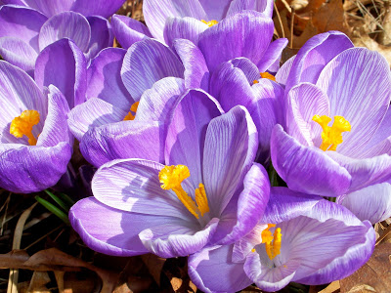
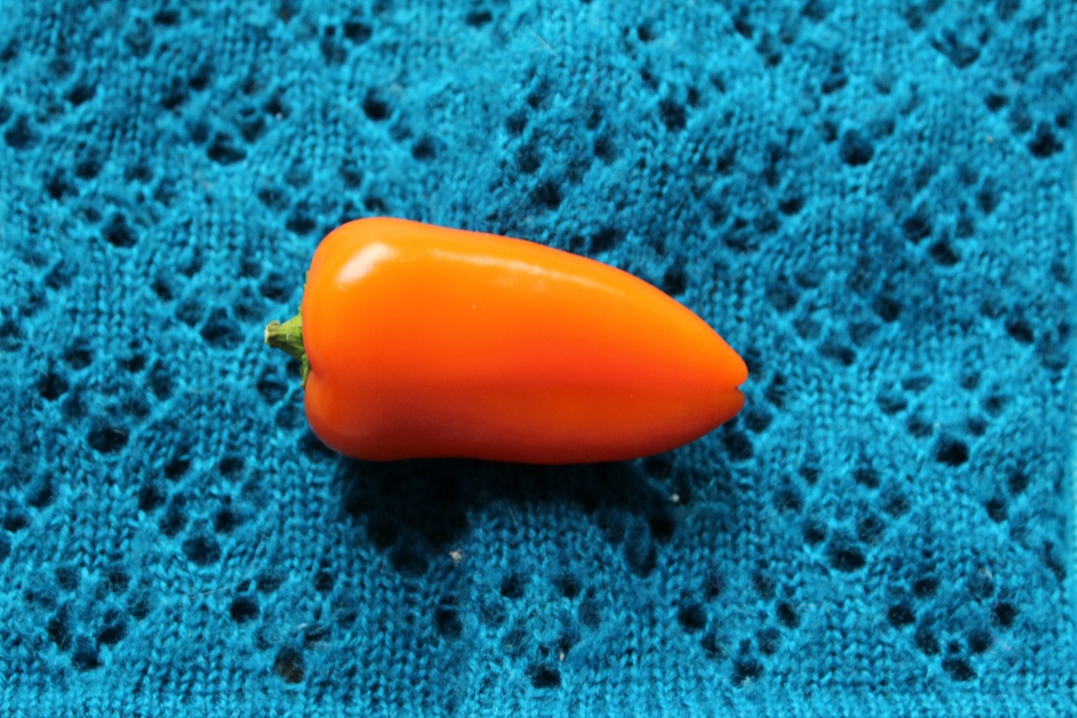
Complimentary: Colors across from each other in a color wheel
Notes:
Complimentary colors do exactly what they are named for…..they compliment one another. Complimentary colors are opposite to one another on the color wheel. These color combos include Red-Green, Blue –Orange, Yellow-Purple.

Slide 11
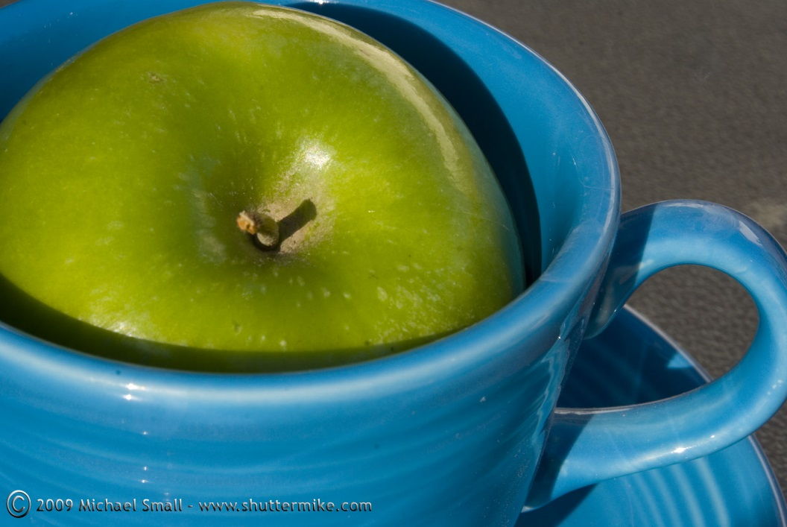
Analogous: colors next to each other on color wheel
Notes:
Kind of a funny name but analogous color schemes are next to each other on the color wheel. Think of them as next door neighbors. Another way to remember 2 types of analogous color schemes is to think of warm and cool colors. Remember those? Warm colors, red, orange, and yellow are all neighbors on the color wheel. The same for cool colors, green, blue, and purple.

Slide 12
Monochromatic: different values of 1 color
Notes:
Last we have monochromatic. With this color scheme you are only working with one hue from the color wheel and using value to enhance it. In other words you are using the hue + the shade (adding black) + the tint (adding white).

Slide 13
Famous works of photography
Notes:
In the following slides you will be presented with a variety of famous photographs taken from all over the world. On the worksheet given write down the subject matter, the colors being used, and the color harmonies being presented. After we go through each of them, we will then discuss each as a group.

Slide 14
Afghan Girl: Steve Mccurry: National Geographic

Slide 15
Annie Leibovitz: Vogue

Slide 16
Timothy Hogan

Slide 17
Jeremy Cowart

Slide 18
What should I make sure to do? What should I think about?
Think about color and how it can enhance the mood or feelings in a photograph.
Think about every single object in the frame. Are you sure you want it to be there?
Think about what you are trying to say with the photograph. Is it just “pretty”, or are you trying to tell the view something?
Think about the camera angle…is it boring? Does it help to say something about the subject?
Your photograph should reflect everything we have learned so far about:
Physical choices
Photo commandments (avoiding clutter, rule of thirds, etc)
Composition (line, shape, texture)
Shadows and light
What you include in the frame crop out unnecessary backgrounds
PHOTOS MUST BE IN FOCUS!!!!

Slide 19
Photo examples

Slide 20
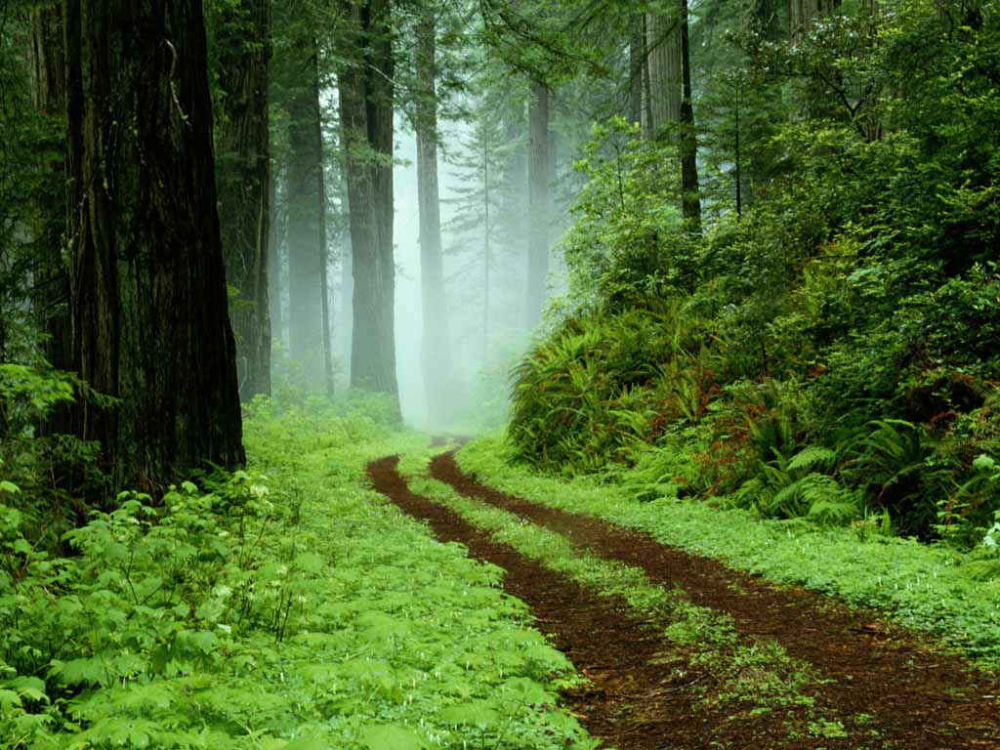

Slide 21
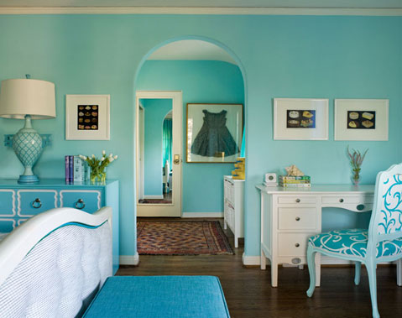

Slide 22
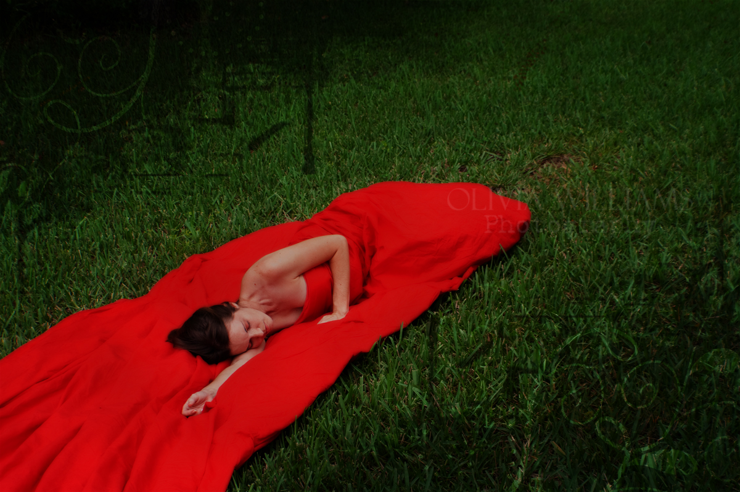

Slide 23
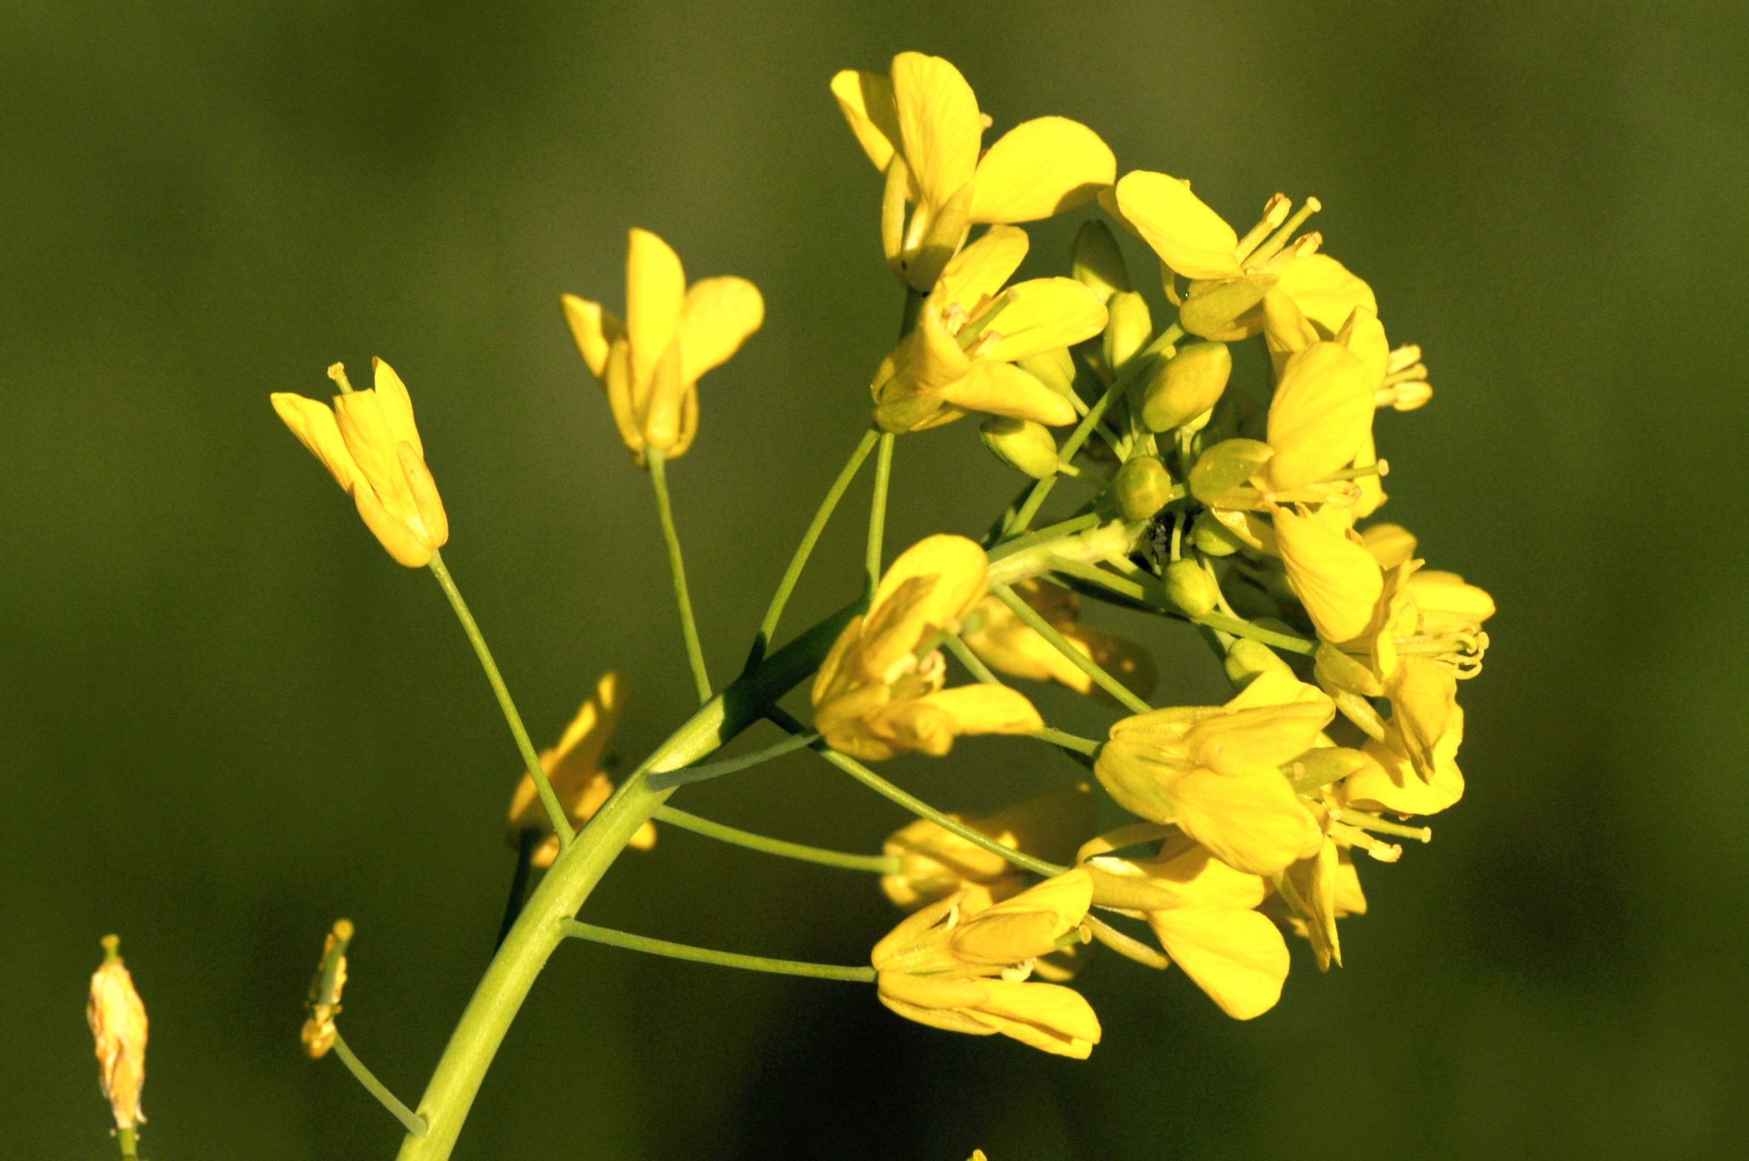

Slide 25
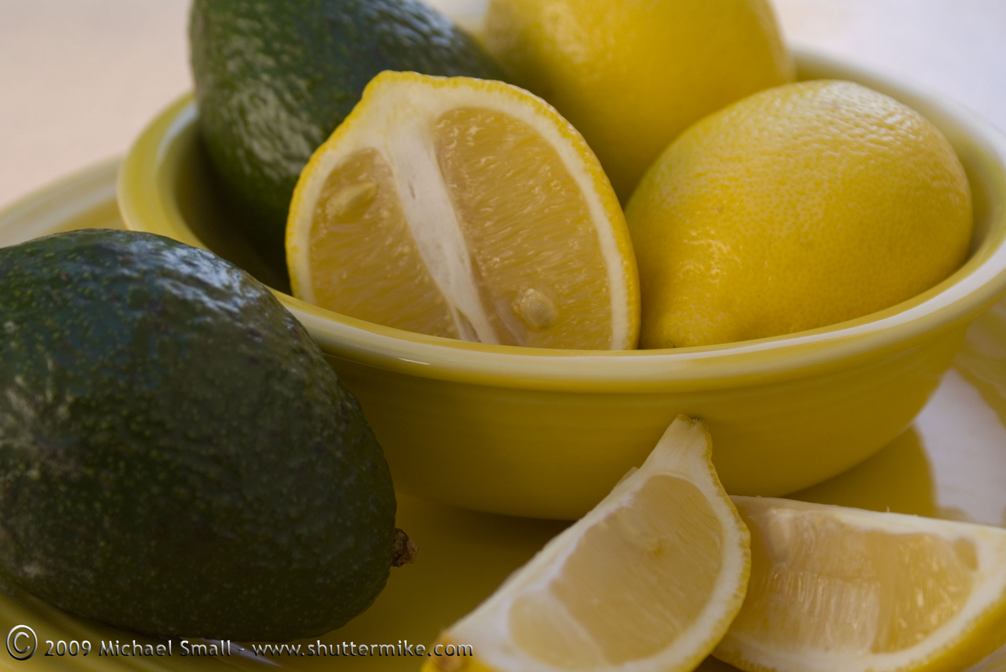

Slide 26
