Slide 1
Cordelia Kraus
Photographs by Me

Slide 2


Slide 3
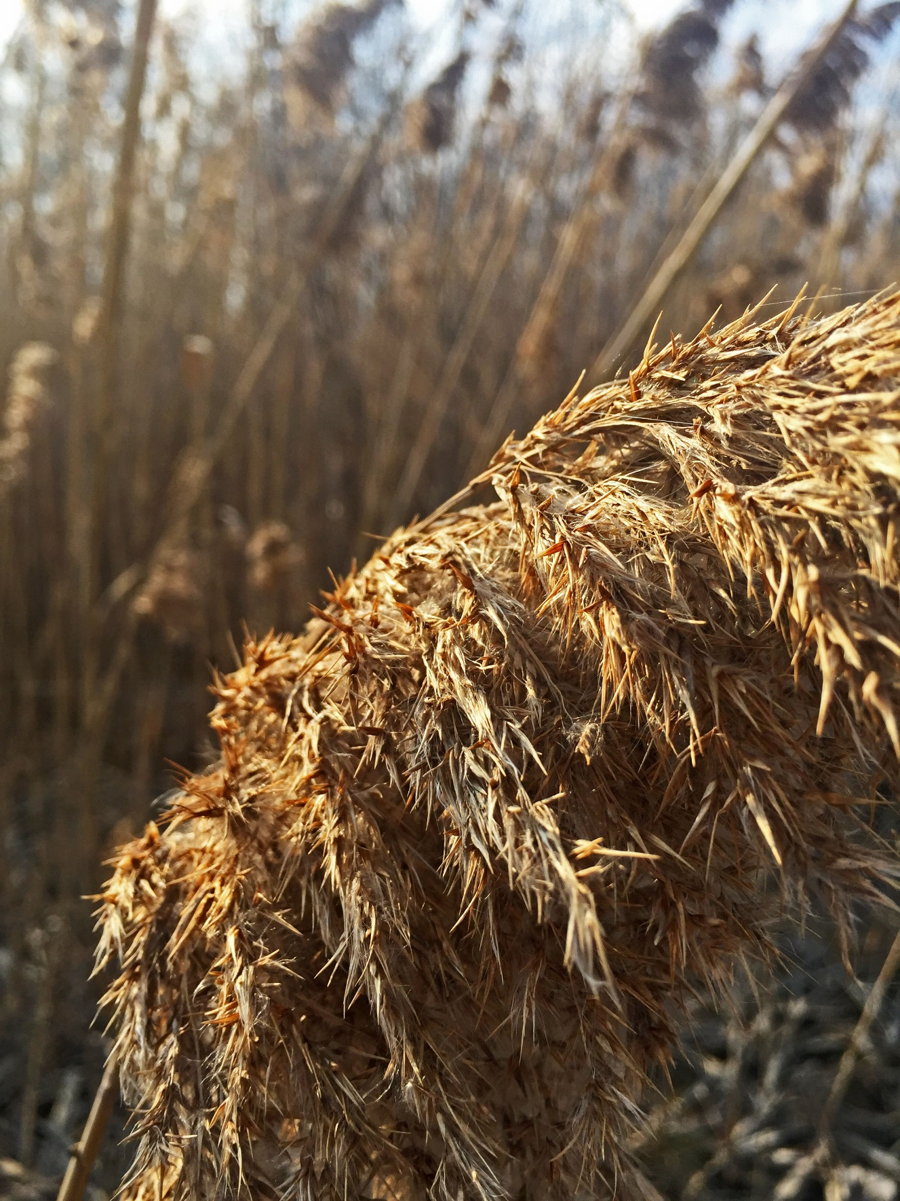

Slide 4


Slide 5
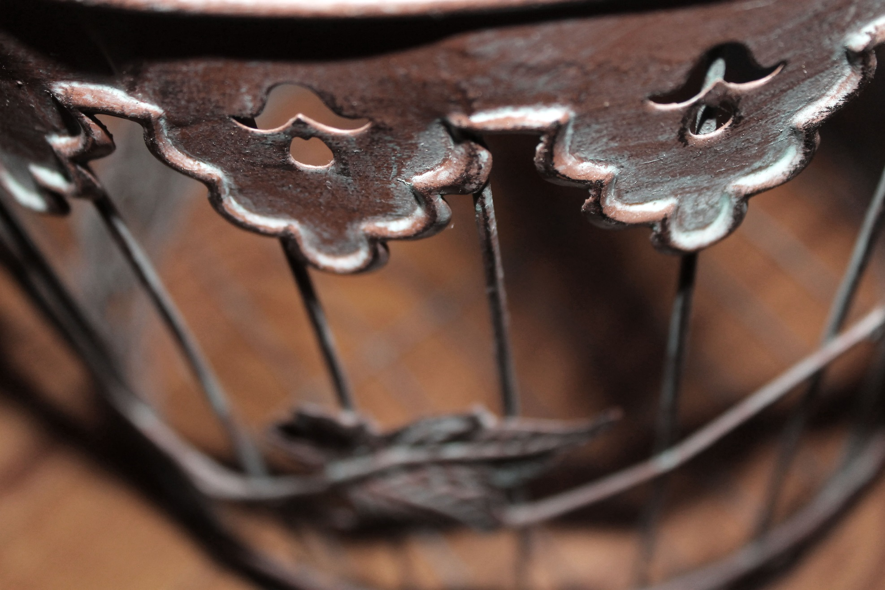

Slide 6
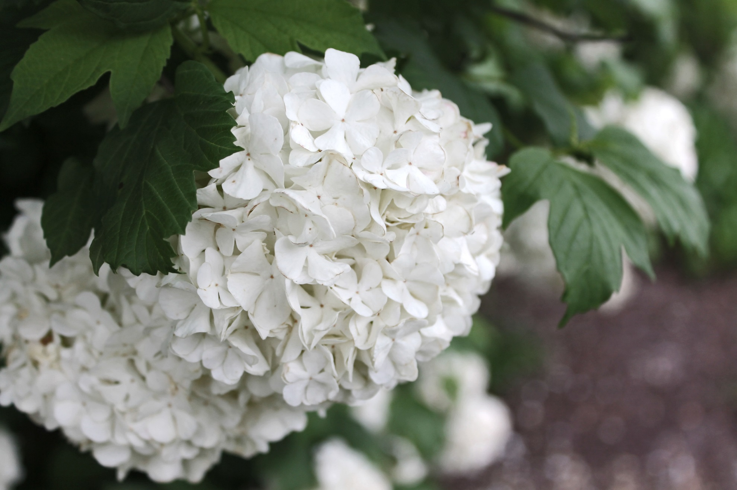

Slide 7
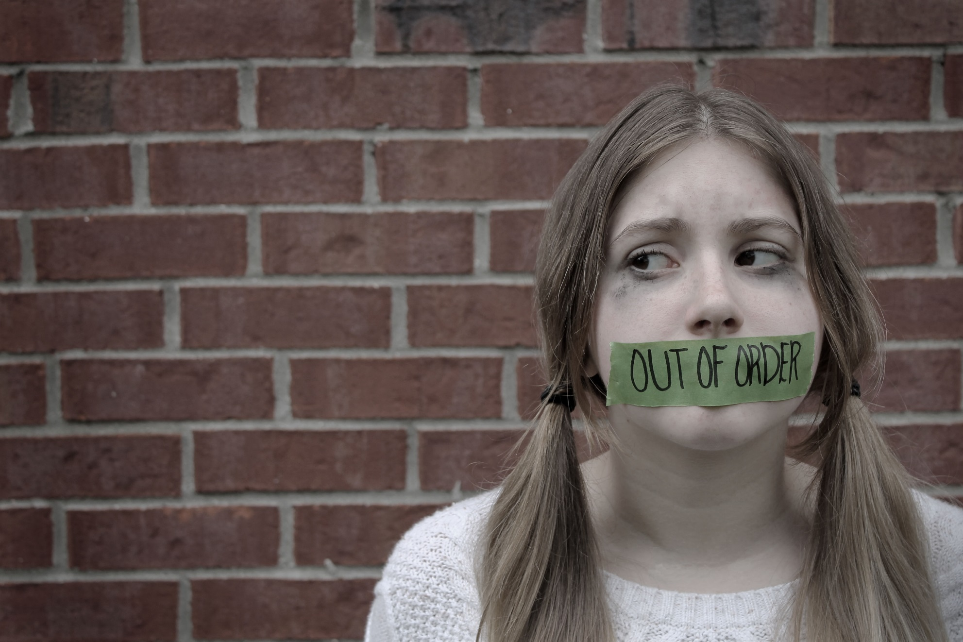

Slide 8
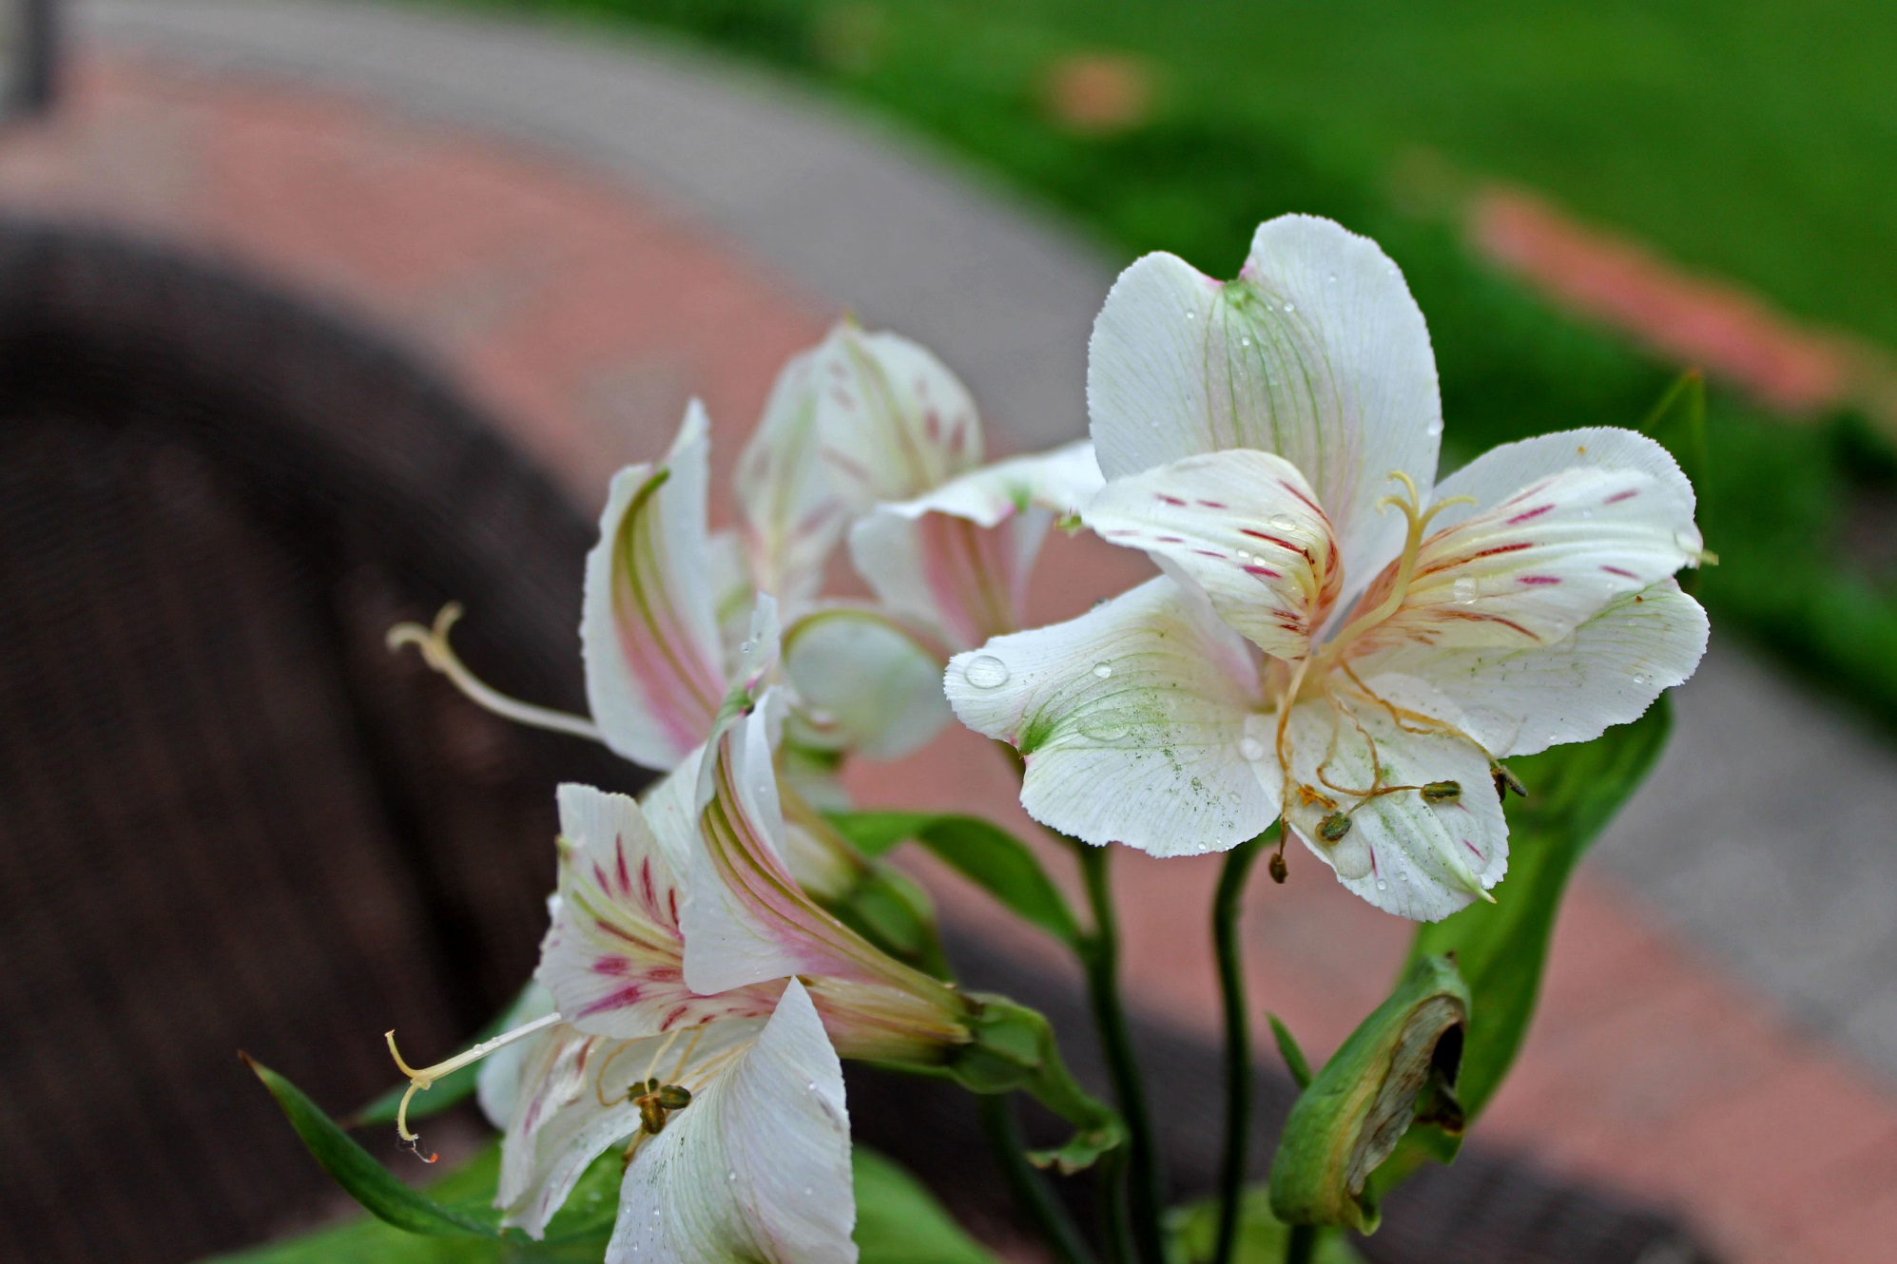

Slide 9


Slide 10
