Slide 1
Fine Art Portraits
Using portraits (pictures of people) to communicate

Slide 2
Video links
The Art of Portrait Photography
https://youtu.be/RjAHkAW8pV4
Guiding questions for Socratic seminar
What are some things communicated in portrait photography?
Select one of the series presented that stuck out to you. And describe how the photographer may have challenged your idea of portraiture.
Explain what the photographer was communicating and were they able to connect to you in some way through their photographs? How? Why?
What questions do you have?
https://youtu.be/weIQIthC3Ks
Guiding Questions
- What are some concepts about Creativity that surprised you?
- Did any of the views or statements about creativity differ than your concept of creativity?
- What do you think it means to be creative?

Slide 3
See, Think, Wonder
● Portraits give us many visual clues to help us determine the possible things being communicated.
● Look at each of the following Photographs.
● Write down everything you see, be sure to look closely and be specific
● Write down what these observations make you think. What could be being communicated in the Photograph? How do your observations help you come to this interpretation?
● What does this Photograph make you wonder?
We will be discussing our thoughts both with our elbow partners and whole class.

Slide 4
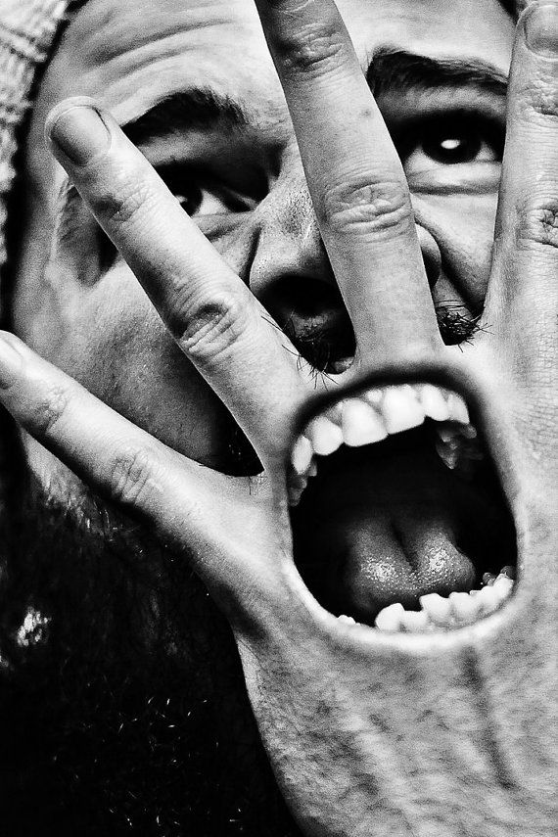

Slide 5
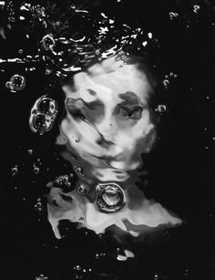

Slide 6
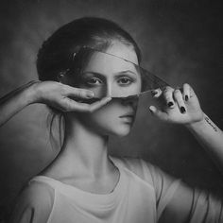

Slide 7
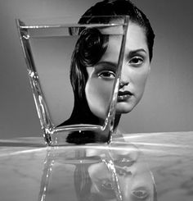

Slide 8
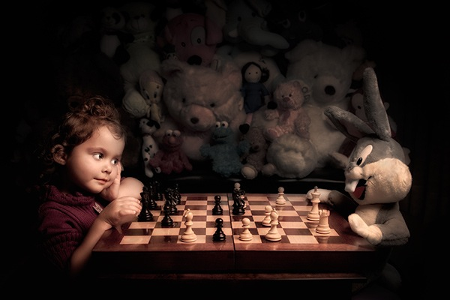

Slide 9
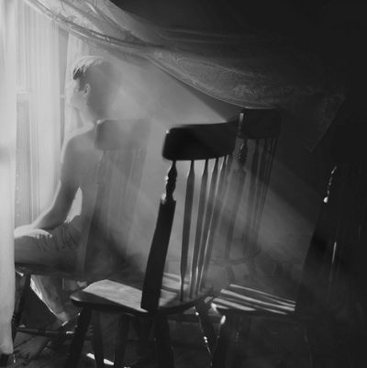

Slide 10
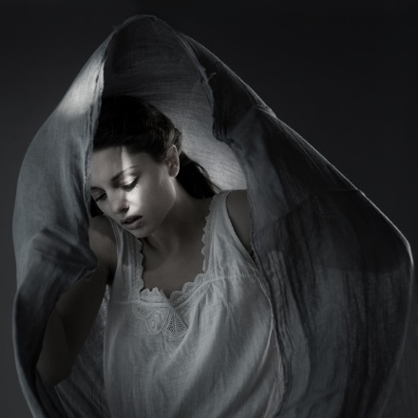

Slide 11
The following is a link to the web page of a UCS student who work primarily in portraiture. We will be looking at and interpreting her work through the visual clues she gives us in each portrait. (See the homepage of the web site for a selection of her work to analyze.
http://vsco.co/emmaheidrich

Slide 12
Photographs by Emma Heidrick

Slide 15
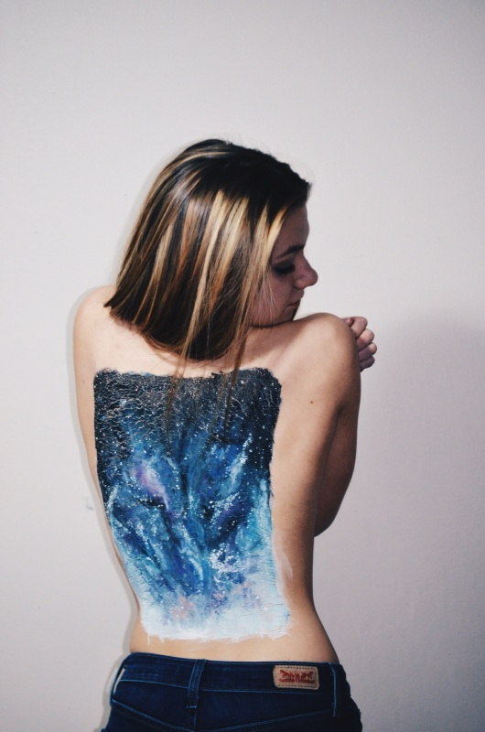
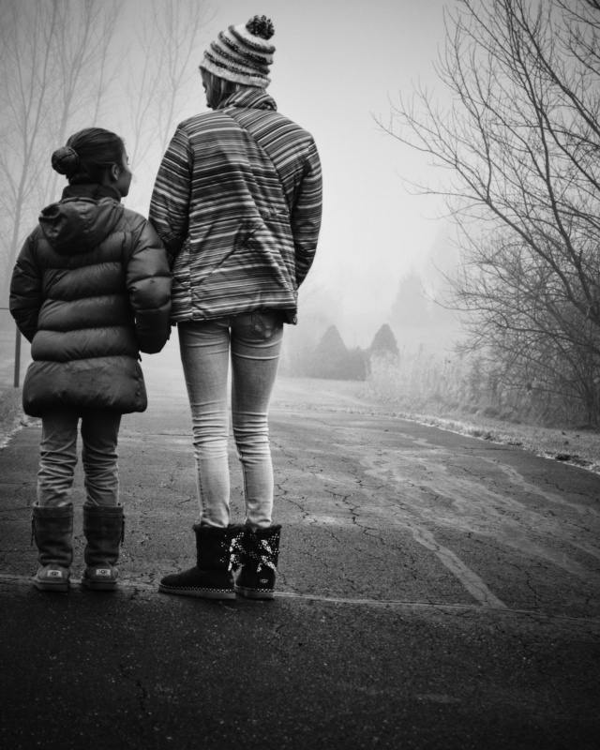

Slide 17
