Slide 1
The Elements and Principles of Art Design

Slide 2
What Are They?
Elements of art are the parts.
They are the building blocks for ANY design.
Principles of design are how the elements are organized in the design.
They affect content and message.

Slide 3
Elements of Design
Line
Form
Space
Texture
Shape
Color
Value

Slide 4
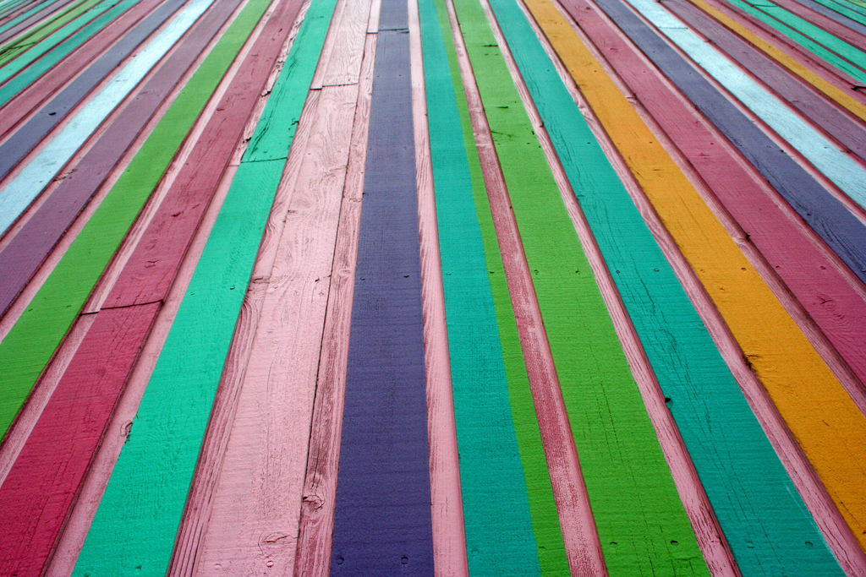
Line
Strokes that show motion and connect two points. May be vertical, horizontal or diagonal, curved, straight, zigzag, or show emotion.

Slide 5
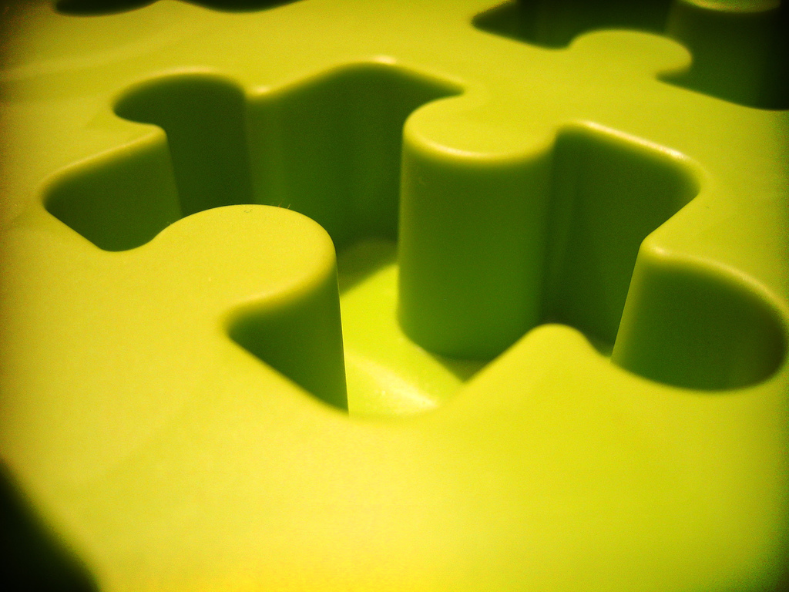
Form
Shows an object in space, the mass or positive space it occupies. The term usually used when describing 3-D objects or something that looks 3-D.

Slide 6
Space
What is between objects, also known as negative space.

Slide 7
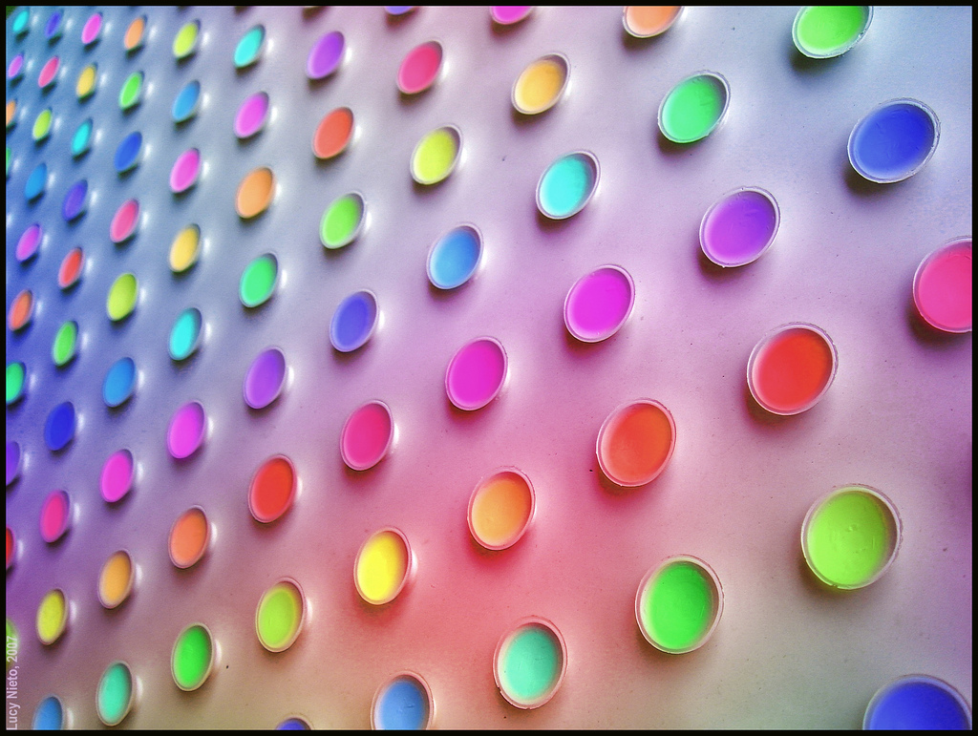
Texture
How something feels or looks like it feels.

Slide 8
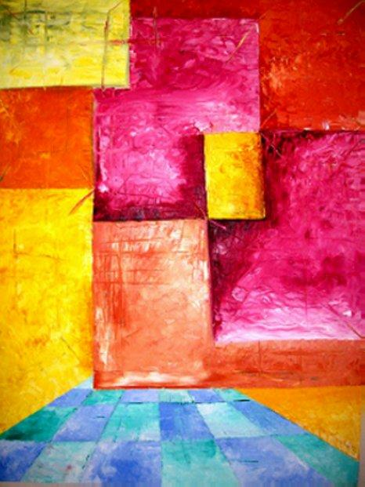
Shape
Area enclosed when both sides of a line meet. Shapes can be geometric or organic (more curvy and less defined).

Slide 9
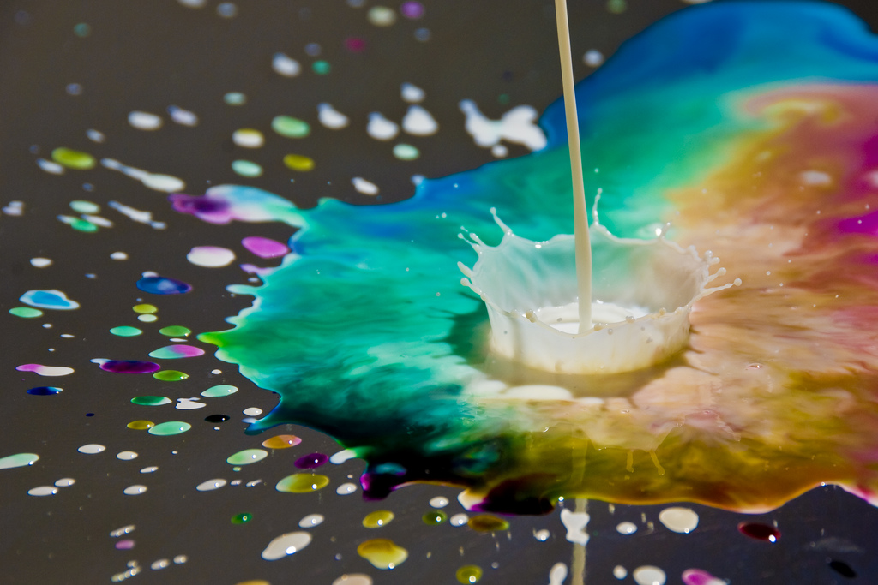
Color
Consists of Hue (the name of a color), value ( the lightness and darkness of a color) and intensity (the POW of a color).

Slide 10
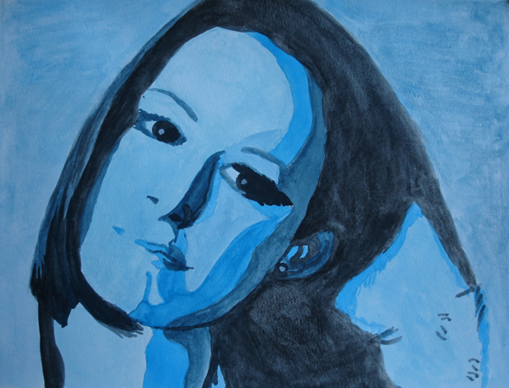
Value
The lightness of darkness of an object or color.

Slide 11
Principles of Design
Emphasis
Movement
Unity
Rhythm
Contrast
Variety

Slide 12
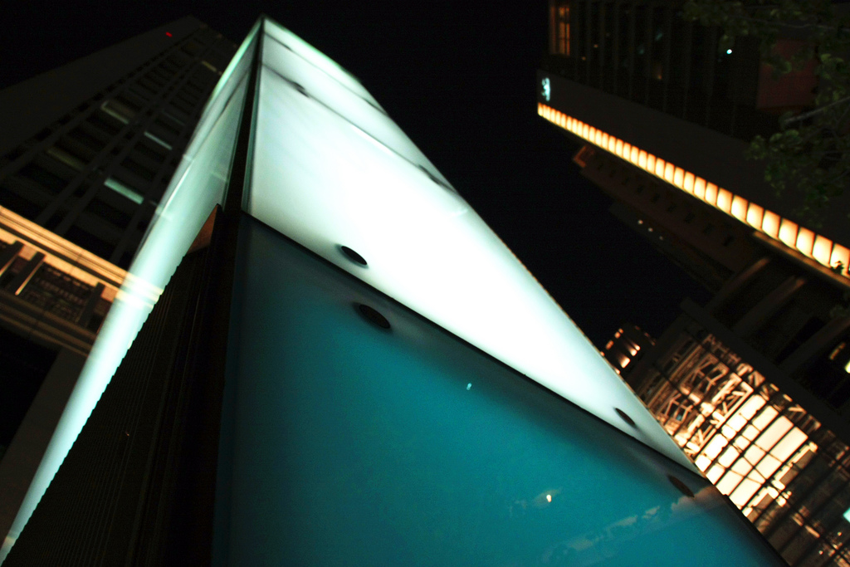
Emphasis
When one area in a work of art stands out more than another. The part that catches your attention first.

Slide 13
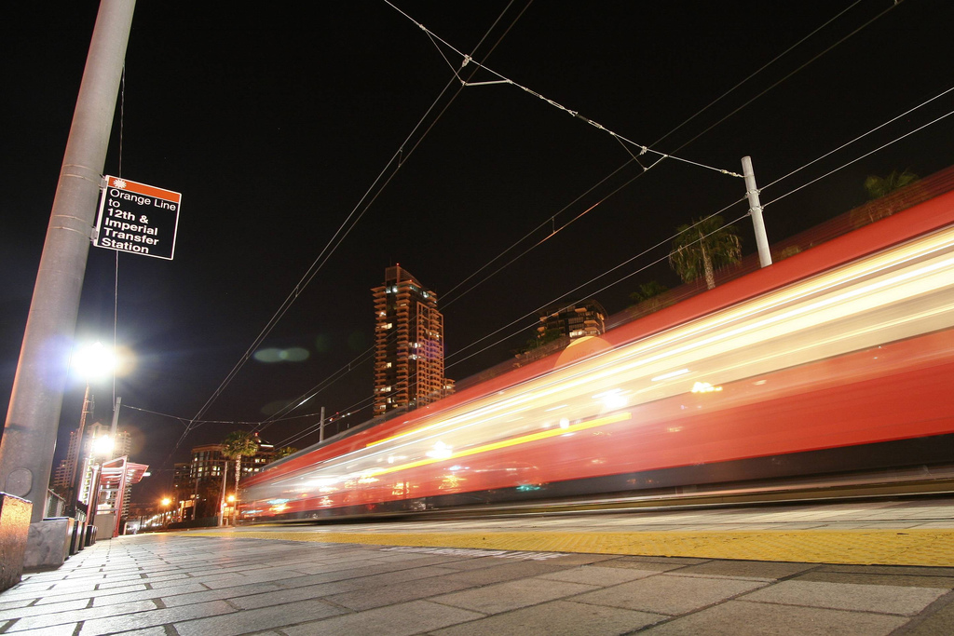
Movement
The motion created in a work of art. Often uses the principle of rhythm to achieve this.

Slide 14
Balance
The visual weight in a photograph. Can be symmetrical (same visual weigh on both sides) or asymmetrical (one side visually heavier than the other)

Slide 15
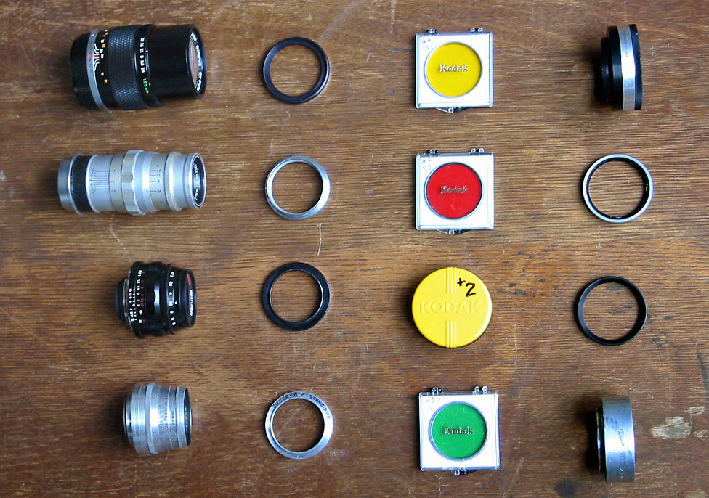
Unity
The feeling of wholeness or the parts belonging together.

Slide 16
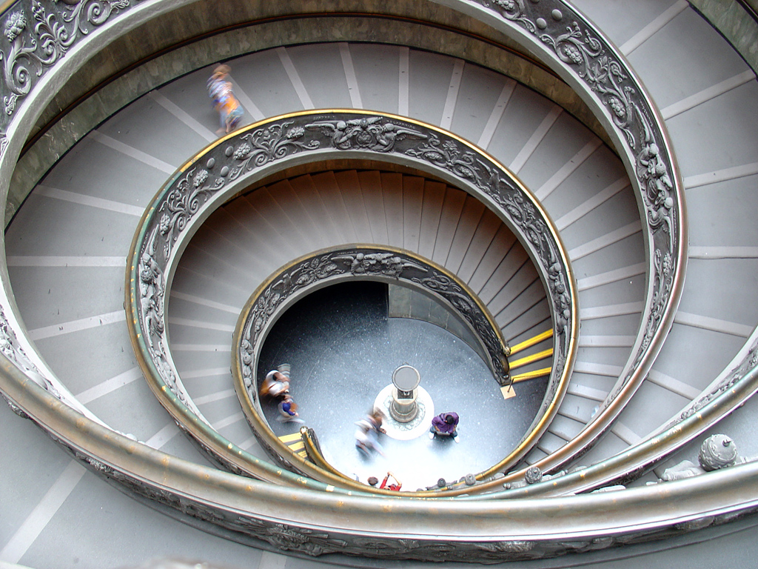
Rhythm
The repetition of lines, shapes, or colors to create a feeling of movement.

Slide 17
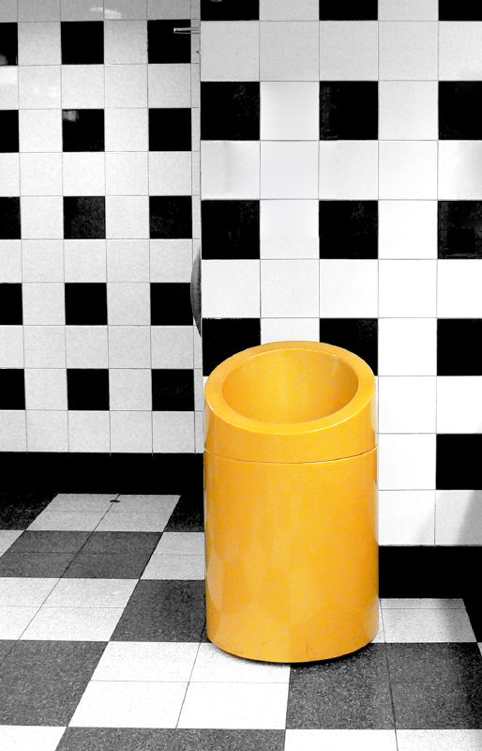
Contrast
A difference created when elements are placed next to each other in a work of art.

Slide 18
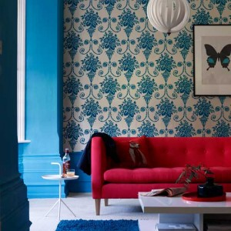
Pattern
The use of similar lines, shapes, and colors in a piece of work.

