Slide 1
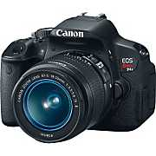
Photography Composition Basics

Slide 2
The Rule of Thirds

Slide 3
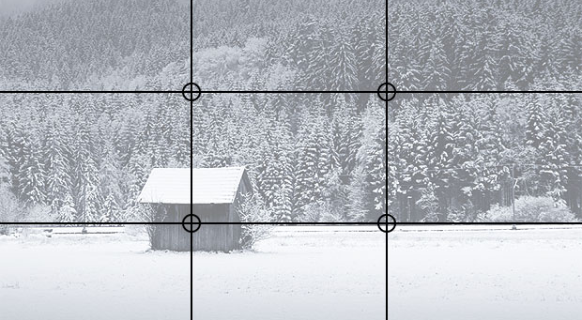
The Rule of Thirds
The rule of thirds involves mentally dividing up your image using 2 horizontal lines and 2 vertical lines, as shown below. You then position the important elements in your scene along those lines, or at the points where they meet.

Slide 4
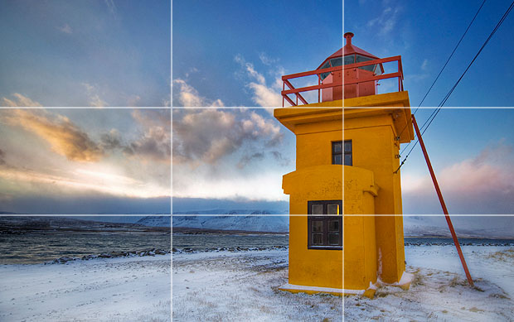
Doing so will add balance and interest to your photo.

Slide 5
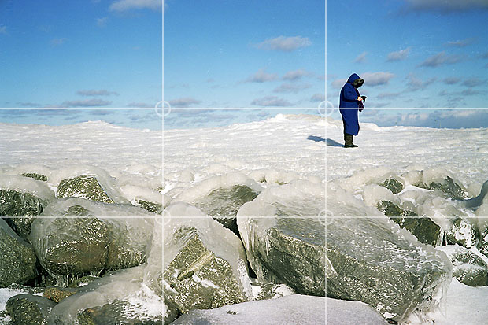
Try to position them at or near the lines and intersections of the grid. They don't have to be perfectly lined up as long as they're close.
The horizon and main subject in this photo have been positioned near lines or intersections for maximum impact

Slide 6
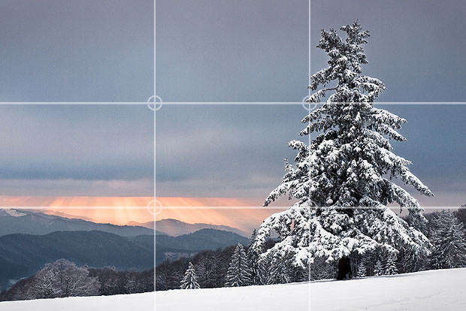
Place the horizon along along one of the horizontal lines.
Try to include another interesting object, such as the tree in the photo above, and position it according to the rule of thirds. This provides an "anchor", a natural focal point for the scene.

Slide 7
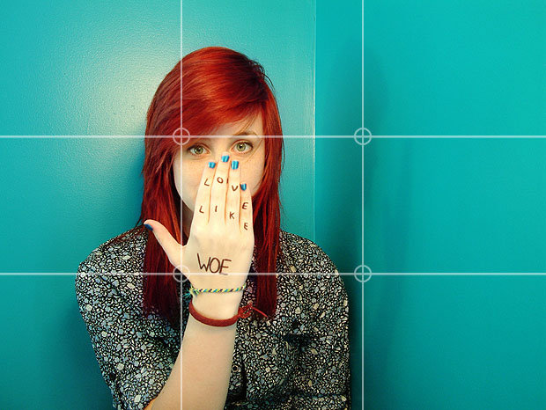
It's a good idea to position people off to one side of the frame. This provides some "breathing space", shows the subject's environment, and stops the photo from looking like a mugshot. We are naturally drawn to people's eyes. Place them at one of the intersections on the rule of thirds grid to give the shot a clear focal point.

Slide 8
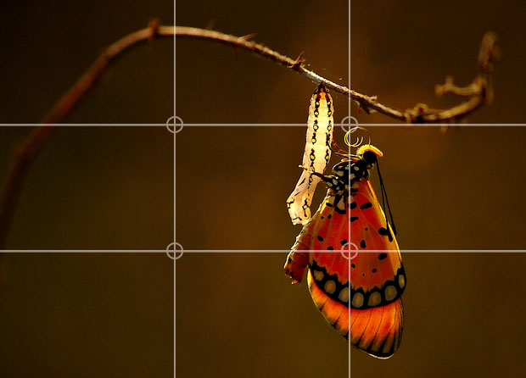

Slide 9
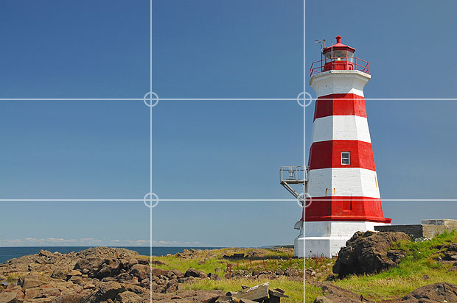

Slide 10
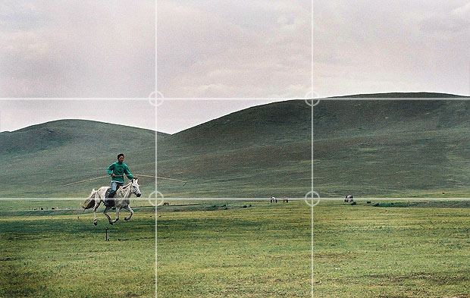
As a general rule you should leave more space in front of them than behind, to show where they're going.

Slide 11
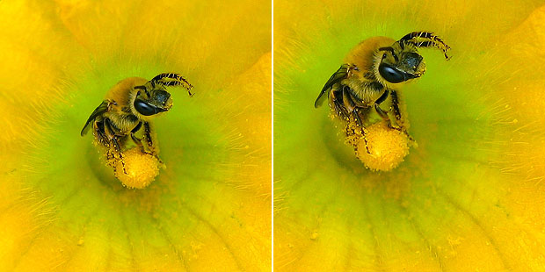
You can easily apply the rule of thirds to existing photos by cropping them. This allows you to reposition the important subjects in your image, moving them into more pleasing positions.

Slide 12
Leading Lines
When we look at a photo our eye is naturally drawn along lines.
By thinking about how you place lines in your composition, you can affect the way we view the image, pulling us into the picture, towards the subject, or on a journey "through" the scene.
There are many different types of line - straight, diagonal, curvy, zigzag, radial etc - and each can be used to enhance our photo's composition.

Slide 13


Slide 14
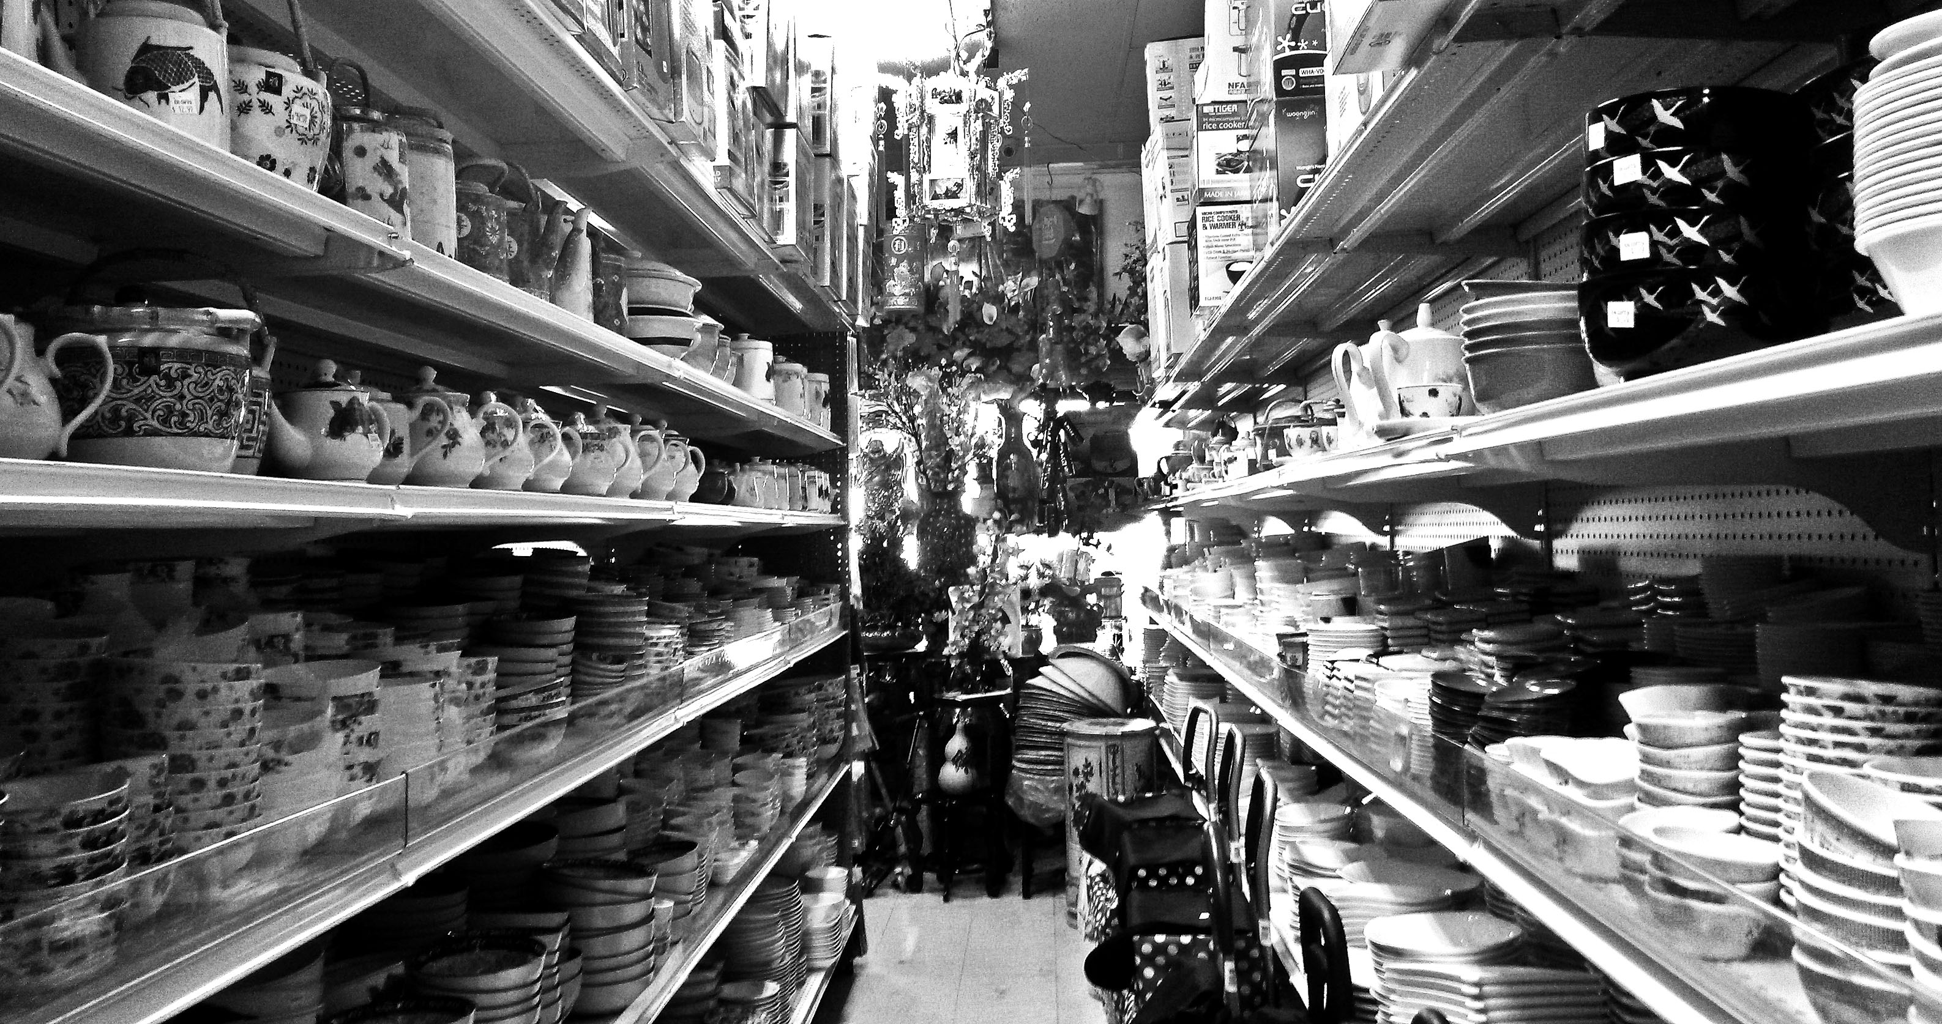

Slide 16
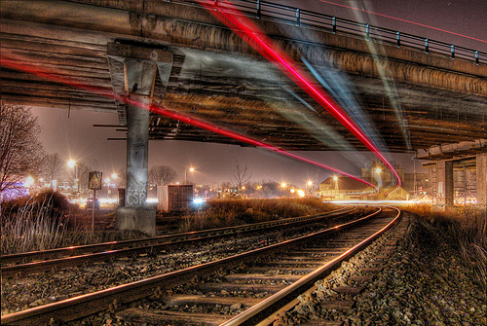

Slide 17
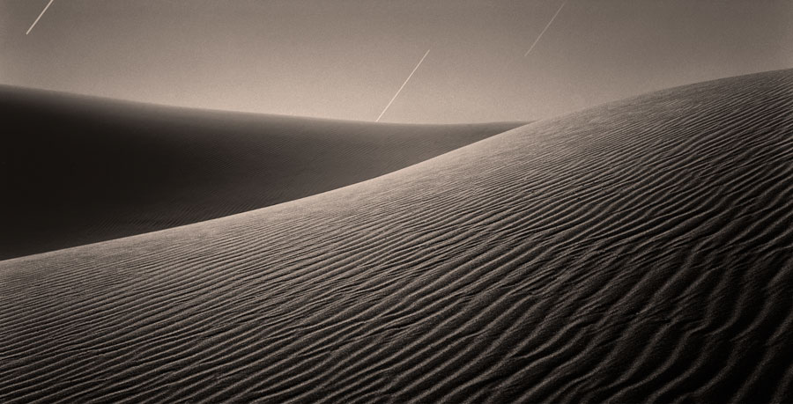

Slide 18
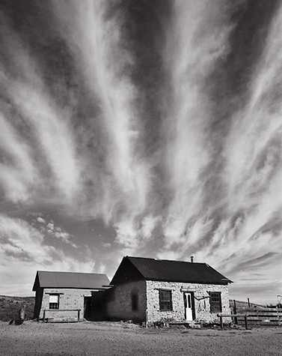
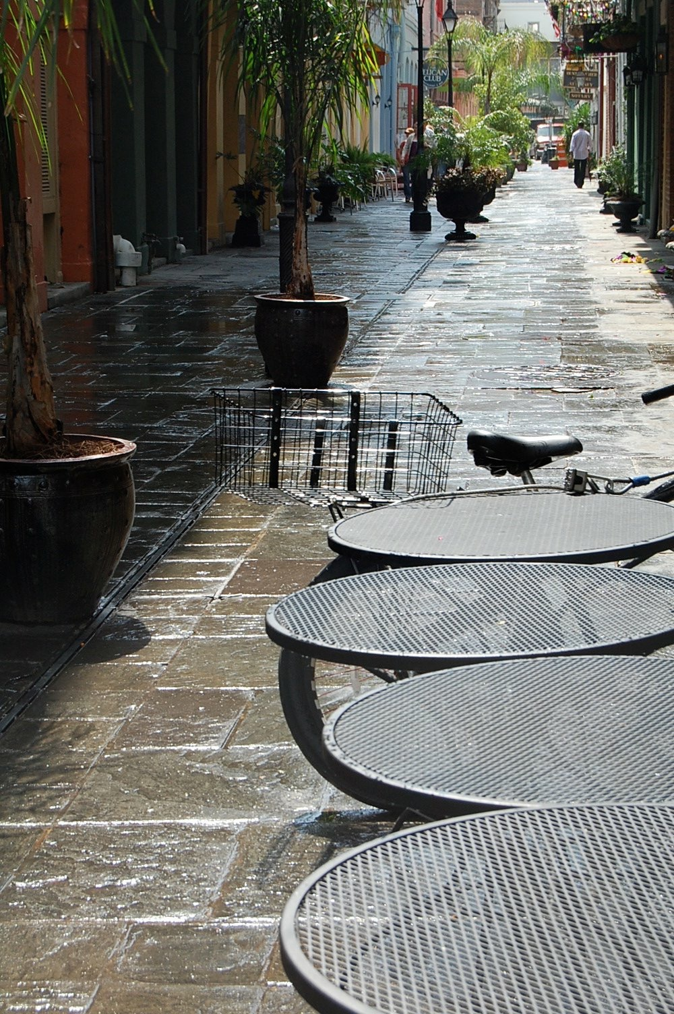

Slide 19
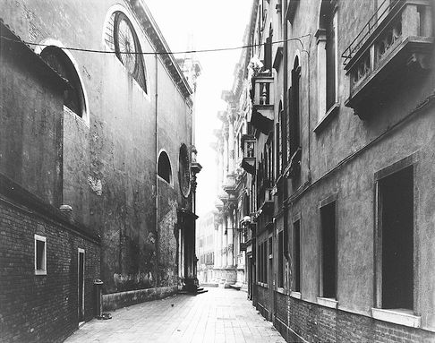

Slide 20
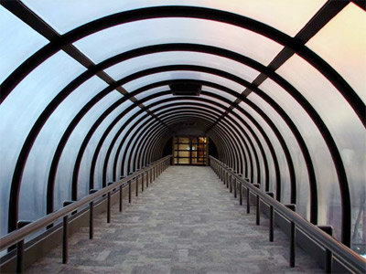

Slide 21
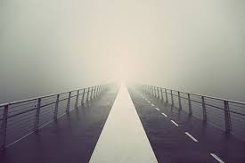

Slide 22
Symmetry and Patterns
We are surrounded by symmetry and patterns, both natural and man-made.,
They can make for very eye-catching compositions, particularly in situations where they are not expected.

Slide 23
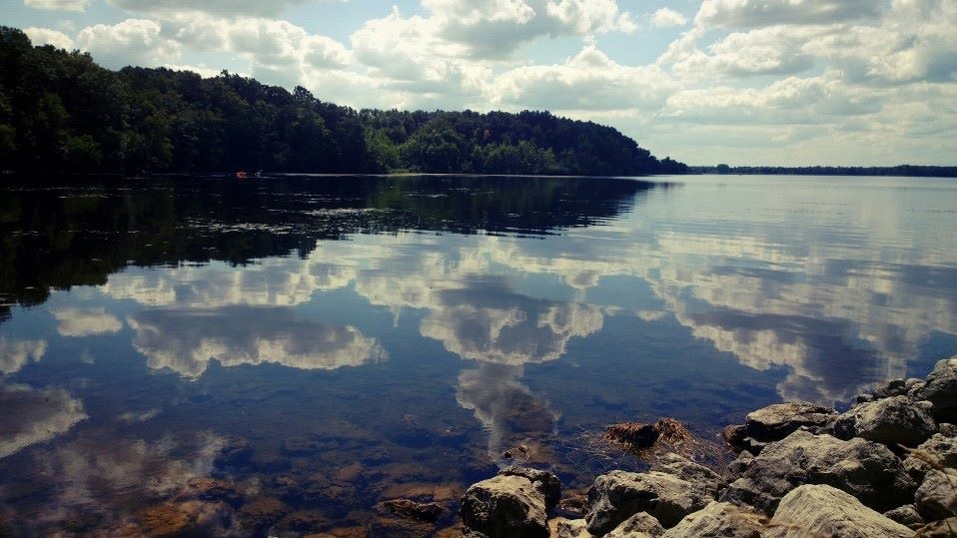

Slide 24
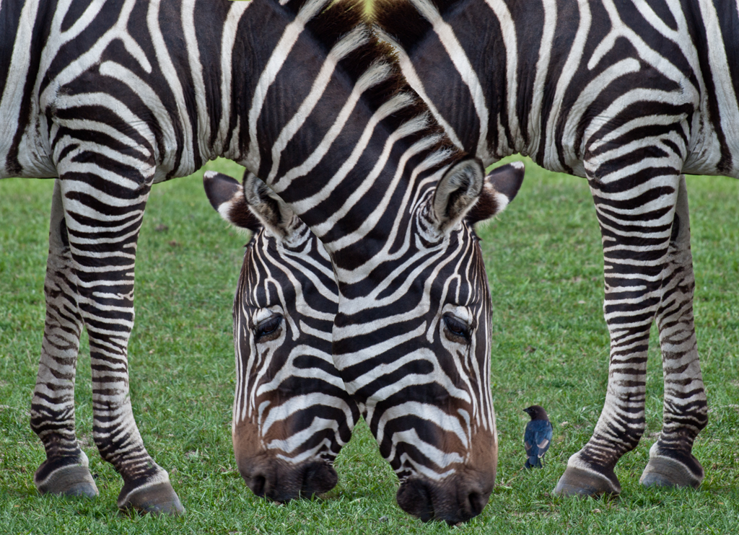

Slide 25
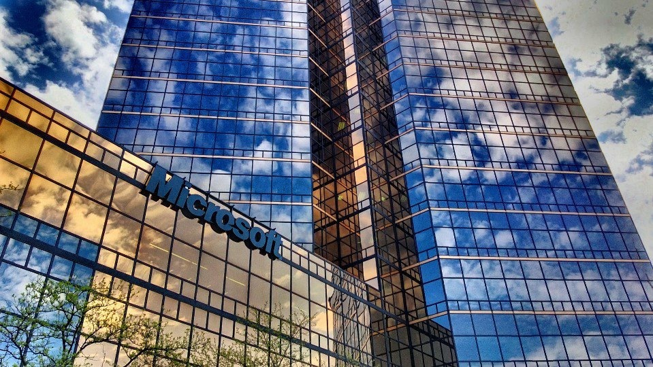

Slide 26
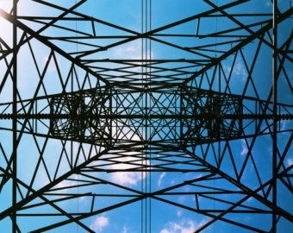

Slide 27
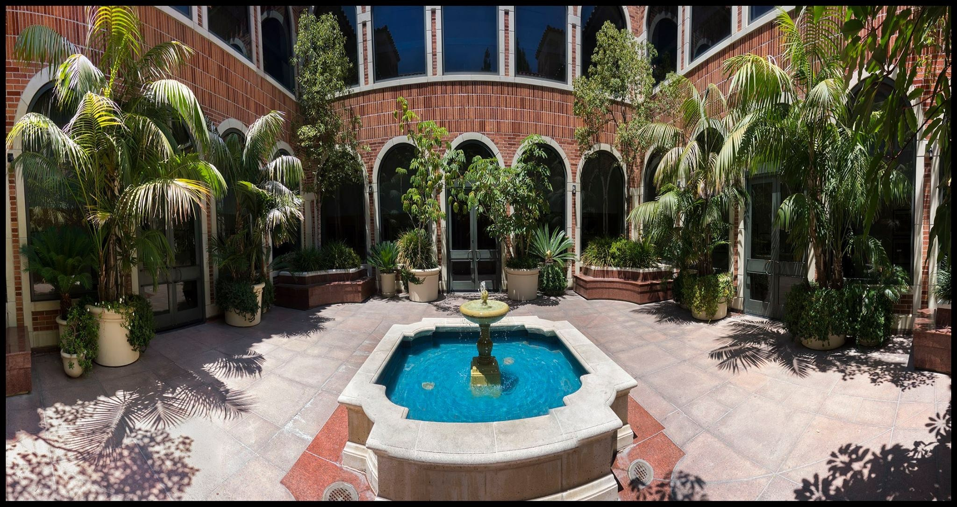

Slide 28
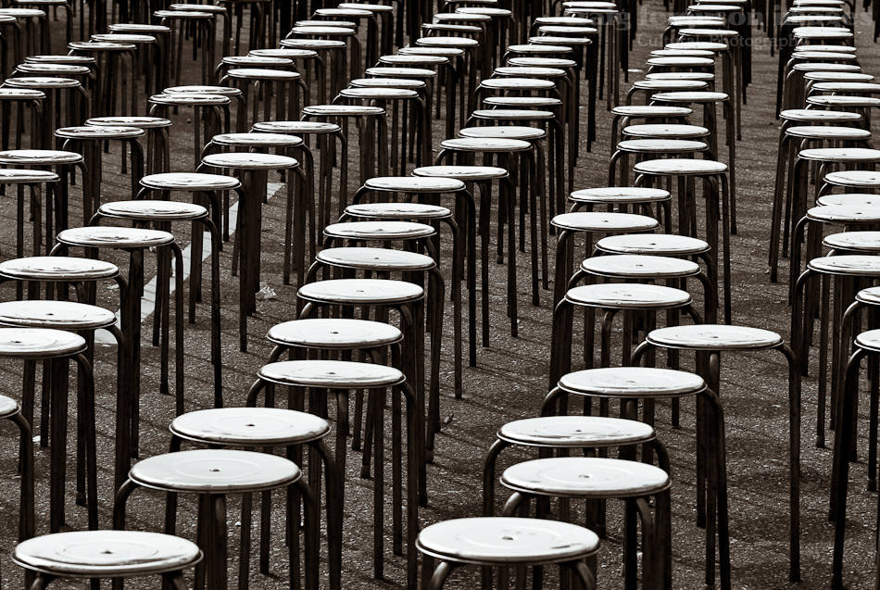

Slide 29
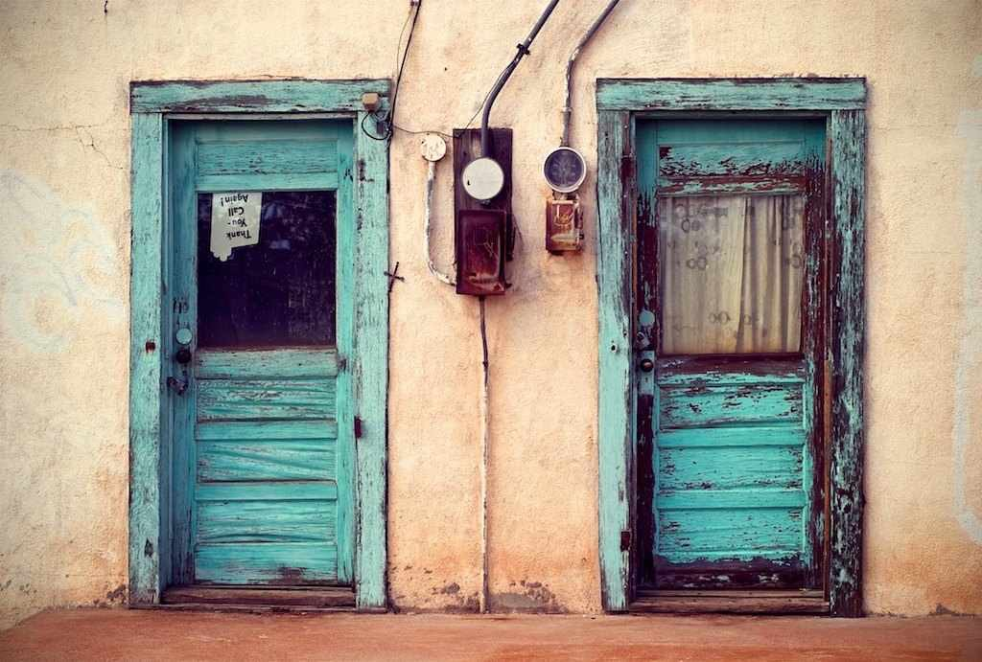

Slide 30

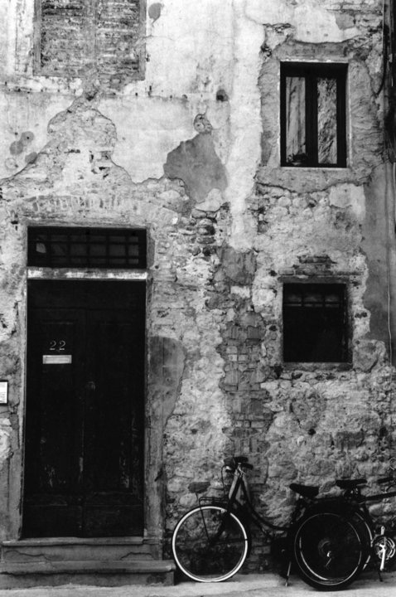

Slide 31
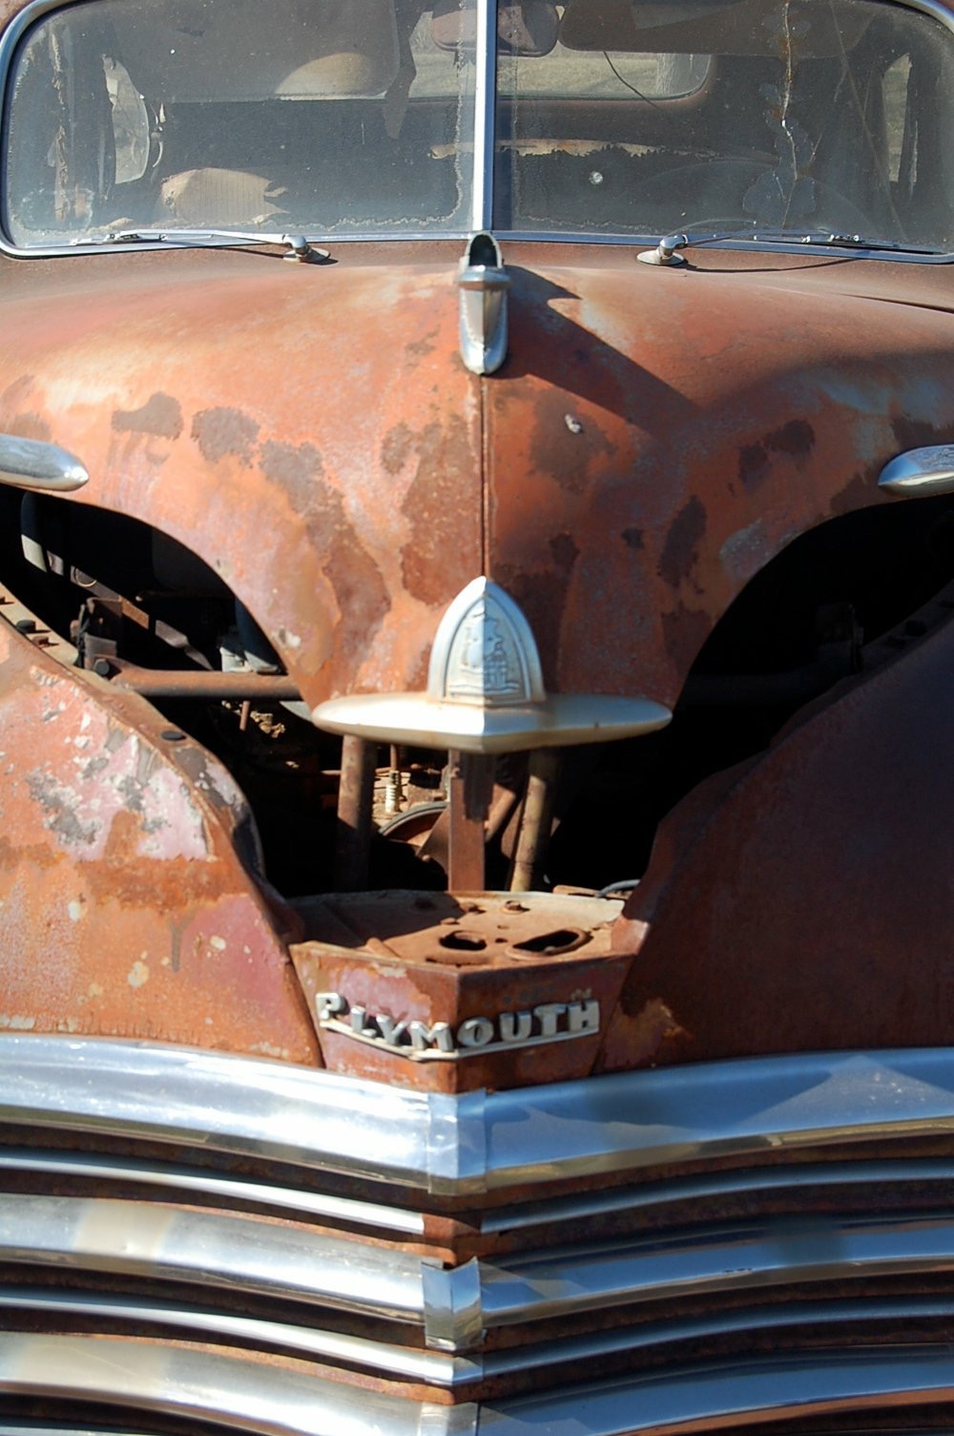
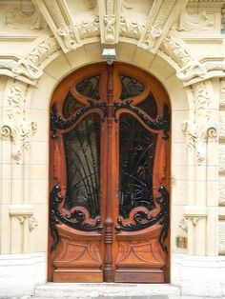

Slide 32
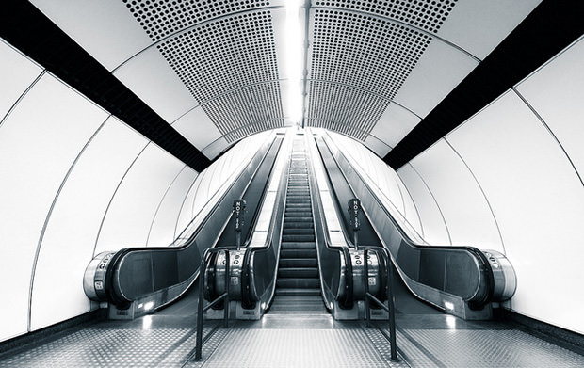

Slide 33
Depth of Field
Because photography is a two-dimensional medium, we have to choose our composition carefully to convey the sense of depth that was present in the actual scene.
How much is in focus from the photographer through the farthest point away from the photographer
Limited depth of field allows a clear focal point…one thing is in focus, everything else is not in focus
Full depth of field: photographer has everything in focus near to far of the photographer
You can create depth in a photo by including objects in the foreground, middle ground and background.

Slide 34
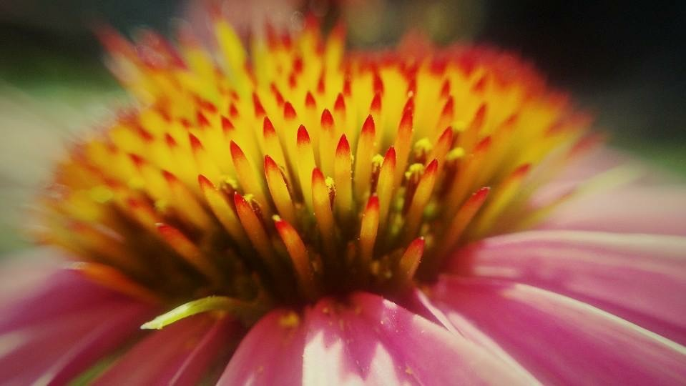

Slide 35
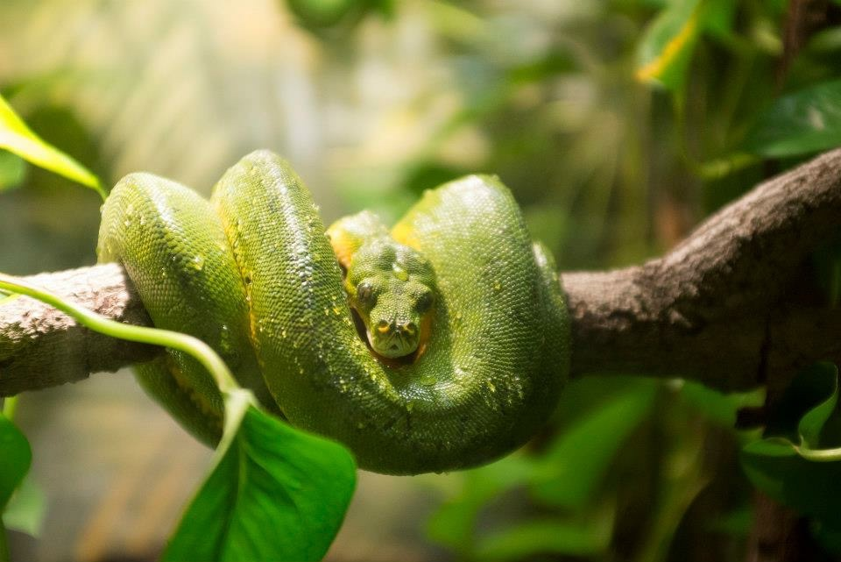

Slide 36
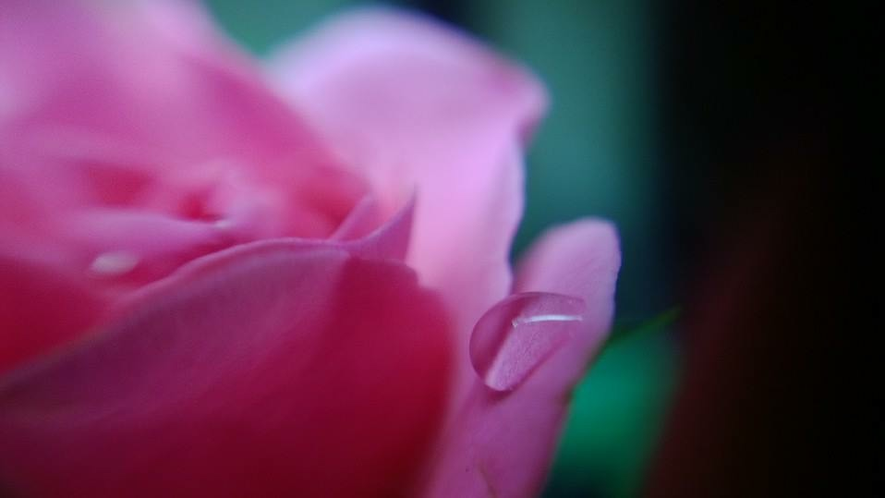

Slide 37
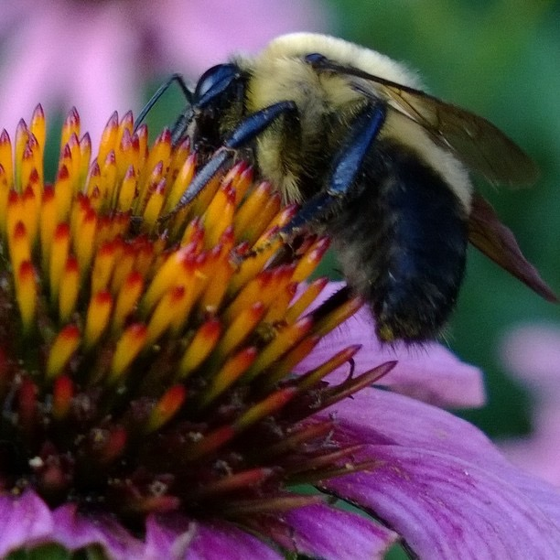

Slide 38
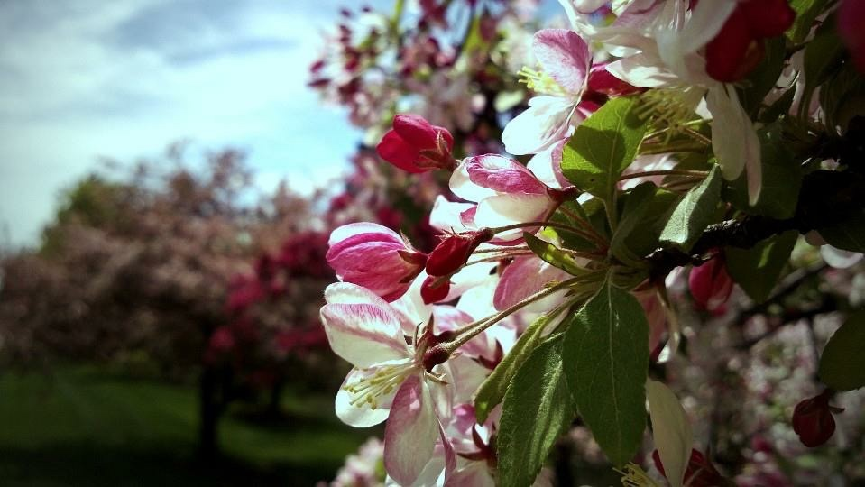

Slide 39


Slide 40


Slide 41


Slide 42
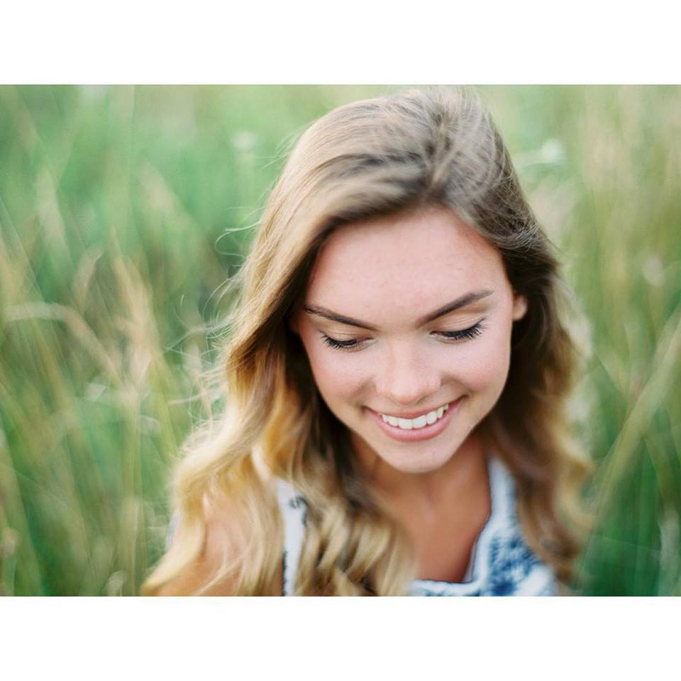

Slide 43



Slide 44
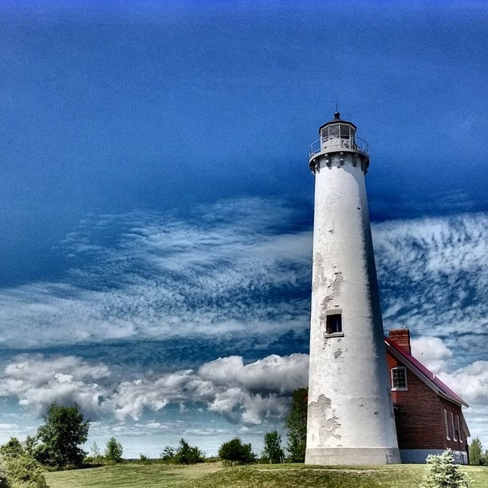

Slide 45


Slide 46
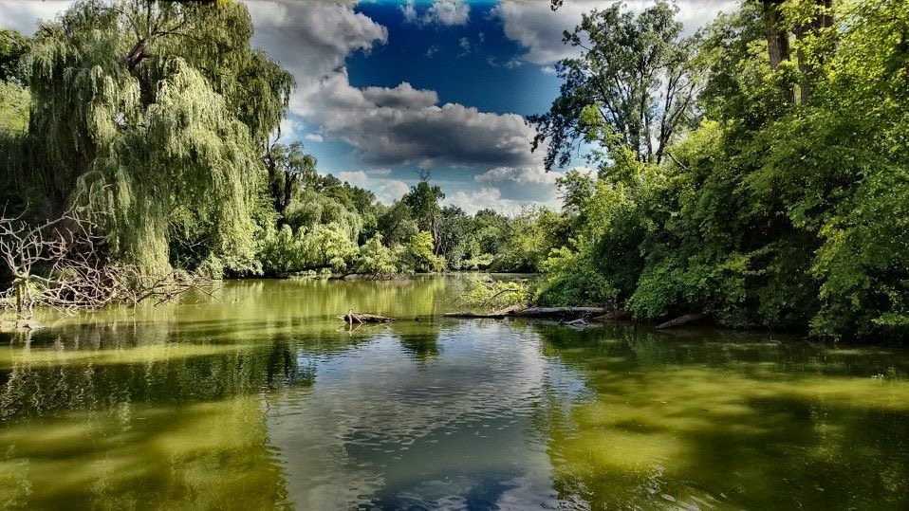

Slide 47
Framing
The world is full of objects, which make perfect natural frames, such as trees, archways holes and even light and shadows.
By placing these around the edge of the composition you help to isolate the main subject from the outside world.
The result is a more focused image, which draws your eye naturally to the main point of interest.

Slide 48
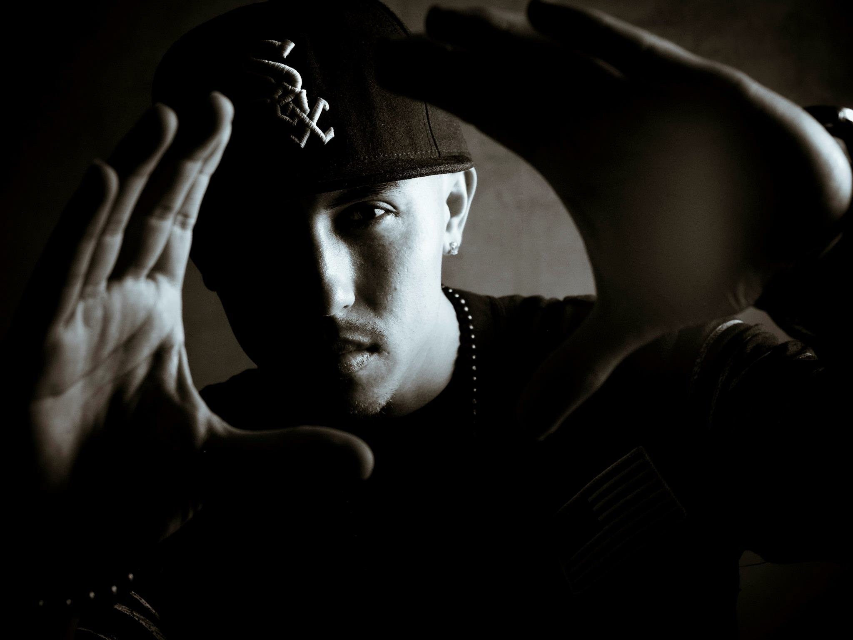

Slide 49
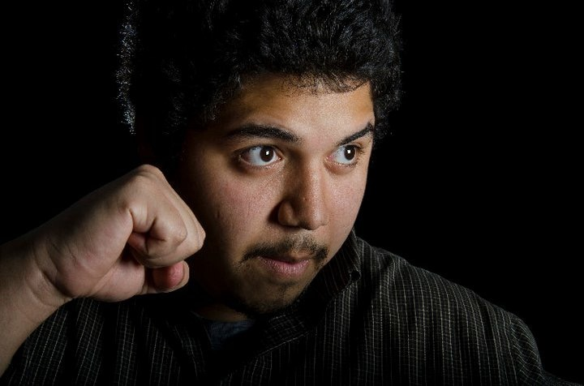

Slide 50
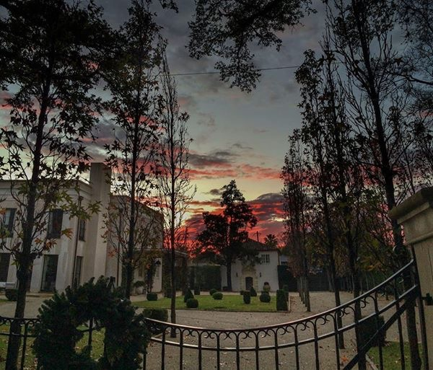

Slide 51
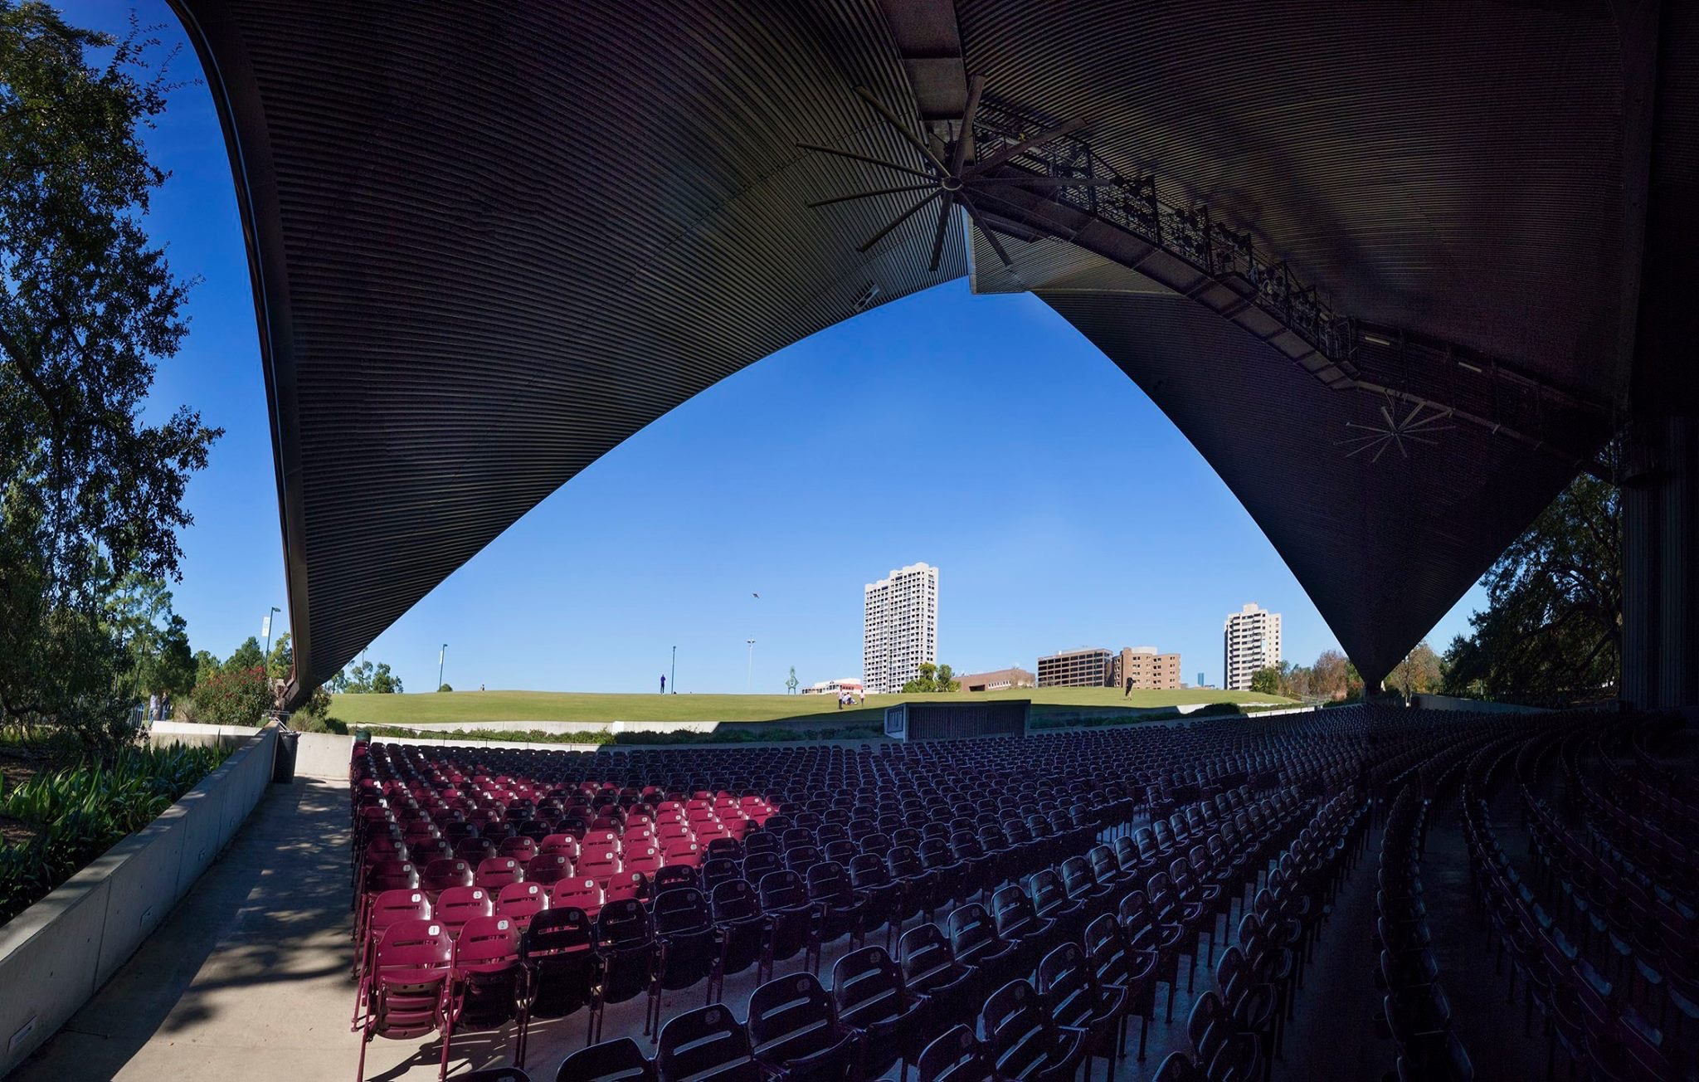

Slide 52
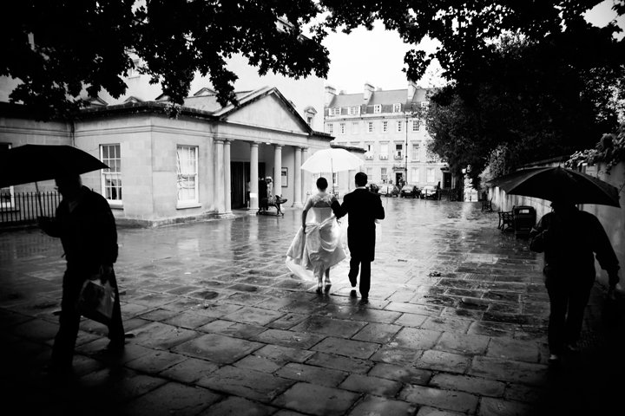

Slide 53
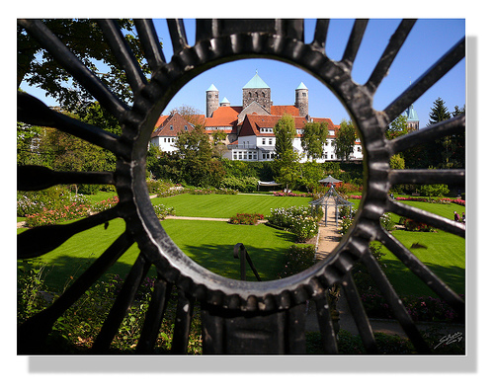

Slide 54
Viewpoint
Before photographing your subject, take time to think about where you will shoot it from.
Our viewpoint has a massive impact on the composition of our photo, and as a result it can greatly effect the message of the photo.
Rather than just shooting from eye level, consider photographing from high above, down at ground level, from the side, from the back, from a long way away, from very close up, and so on.

Slide 55
Bird’s Eye View:
The viewer is looking DOWN on the subject

Slide 56
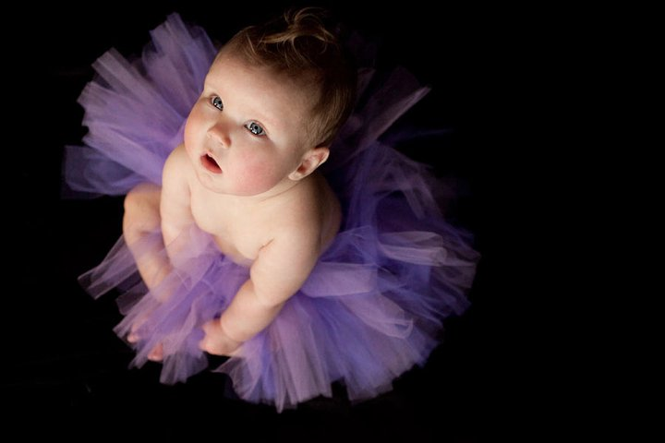

Slide 57
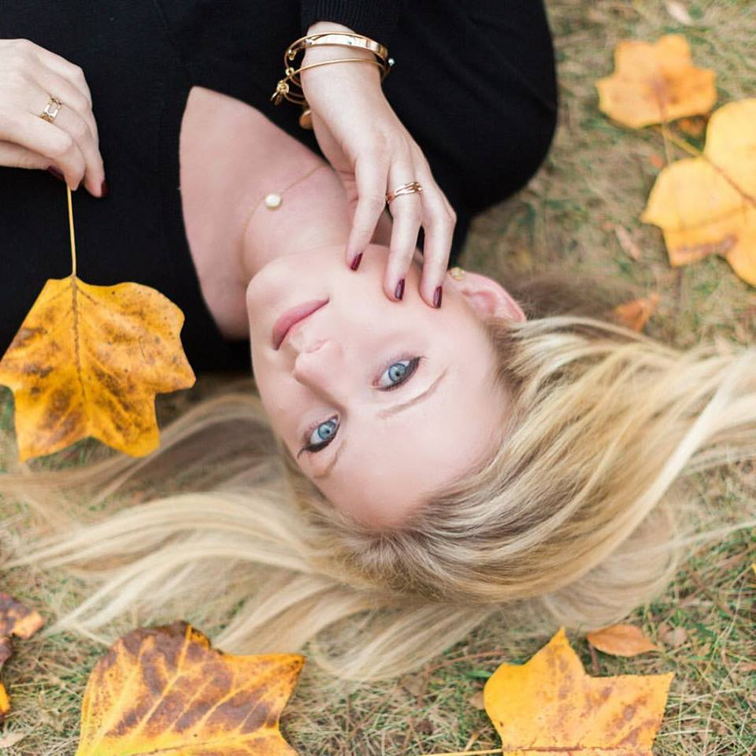

Slide 58
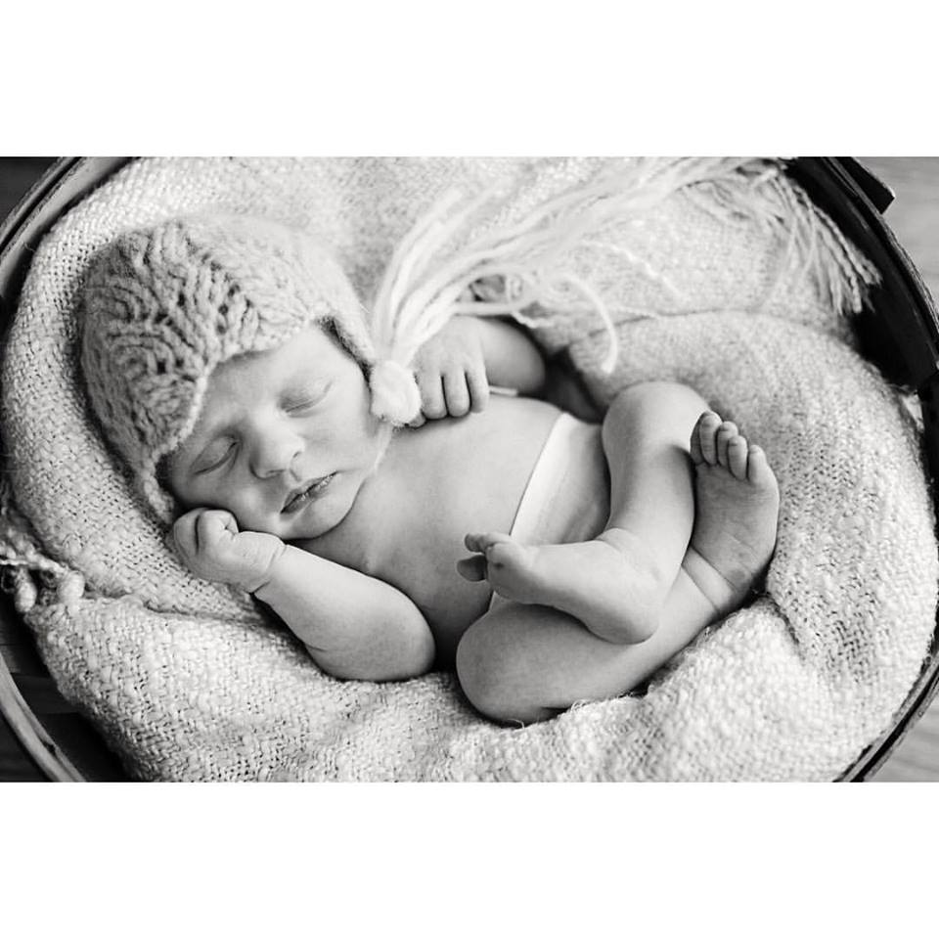

Slide 59
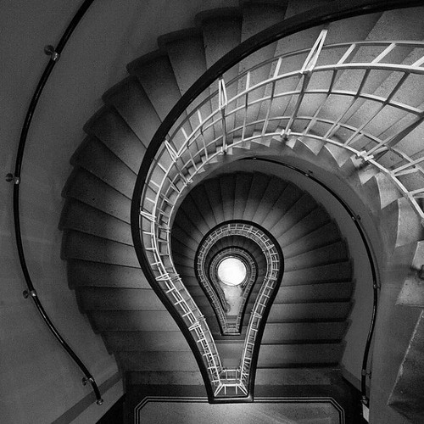

Slide 60
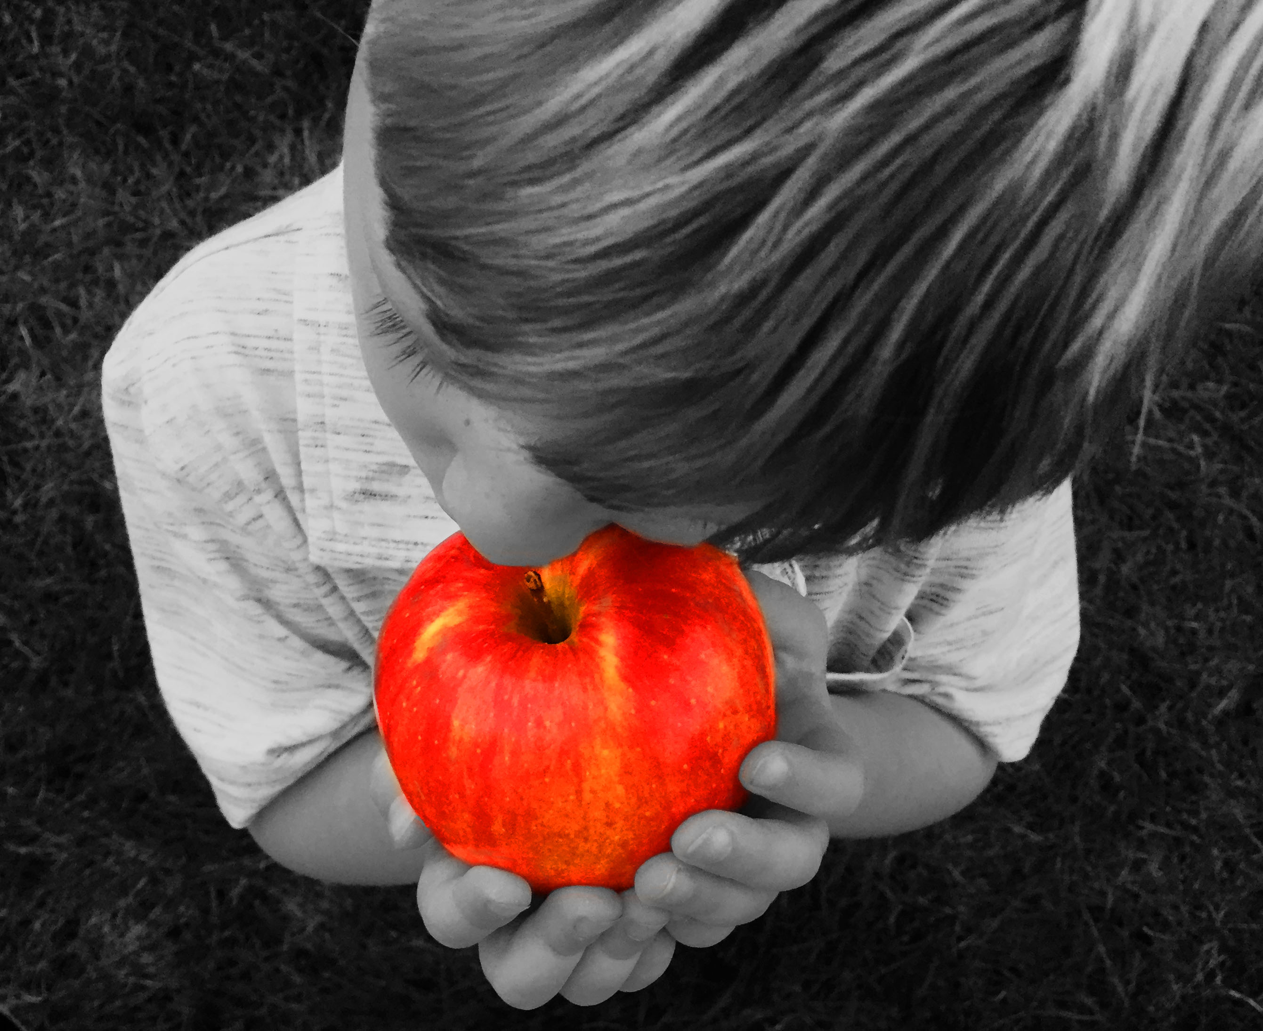

Slide 61
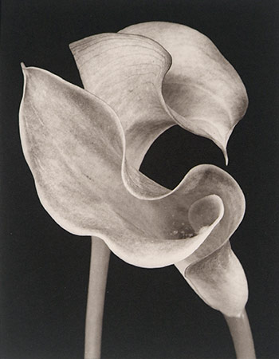

Slide 62
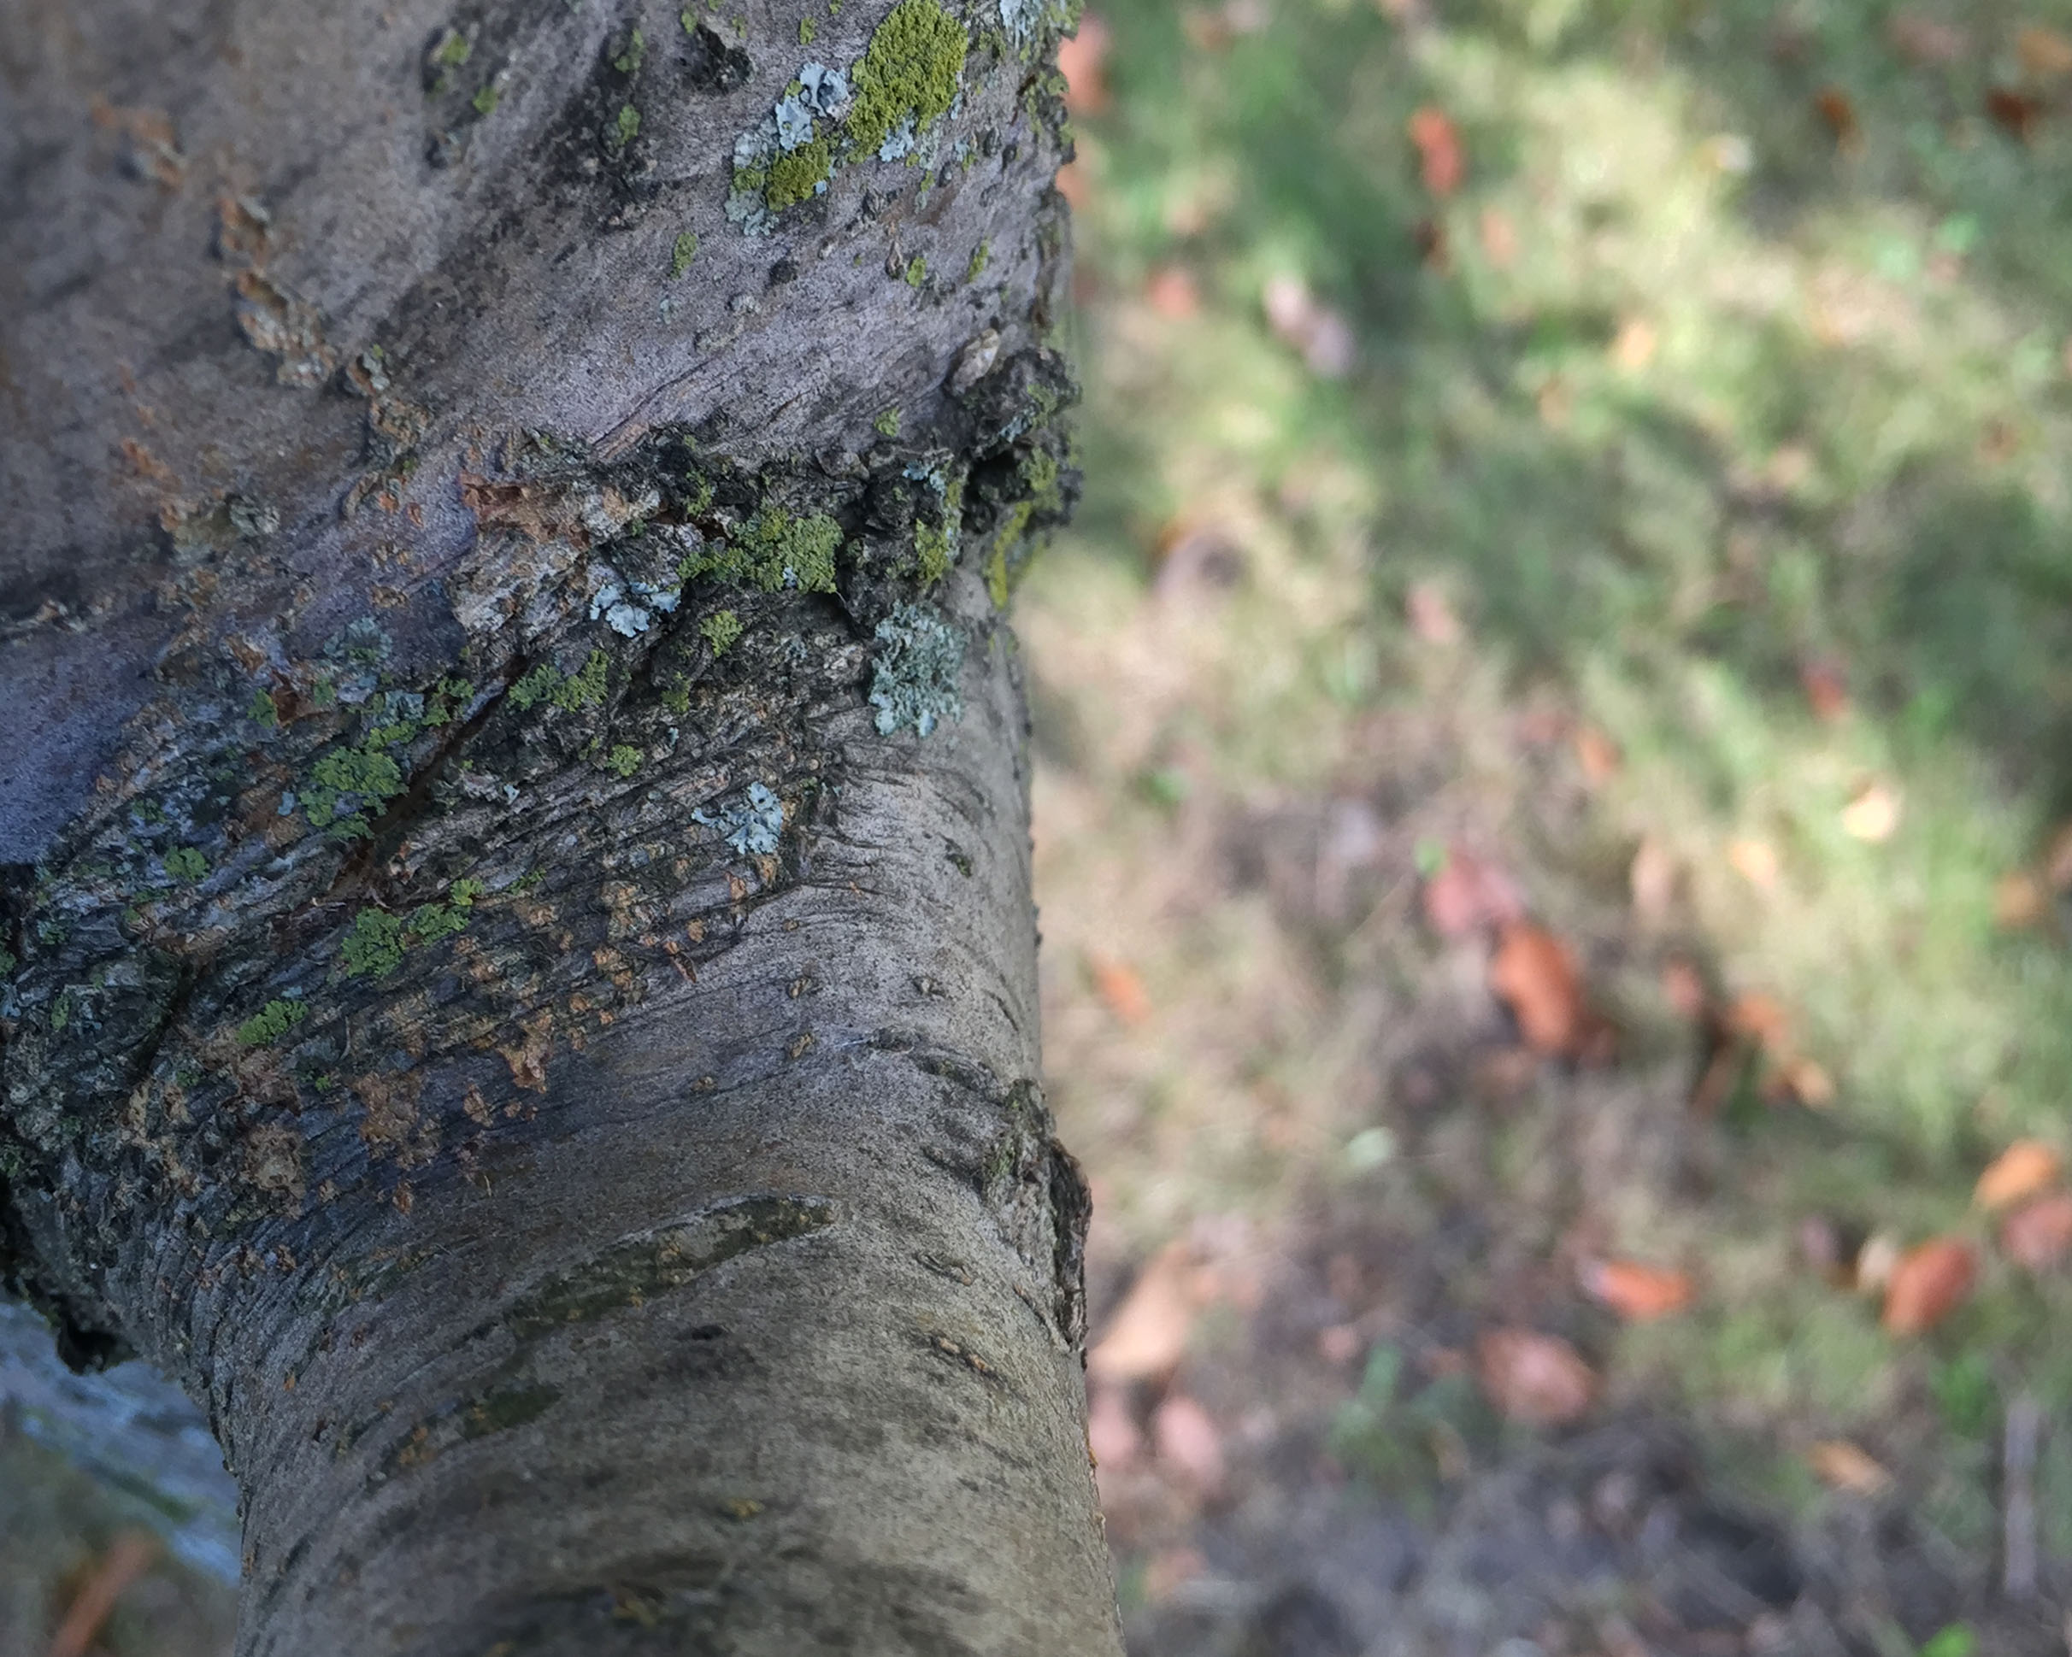

Slide 63


Slide 64
Worm’s Eye View:
Viewer is looking UP at the subject

Slide 65


Slide 66


Slide 67


Slide 68


Slide 69


Slide 70


